Slide 1
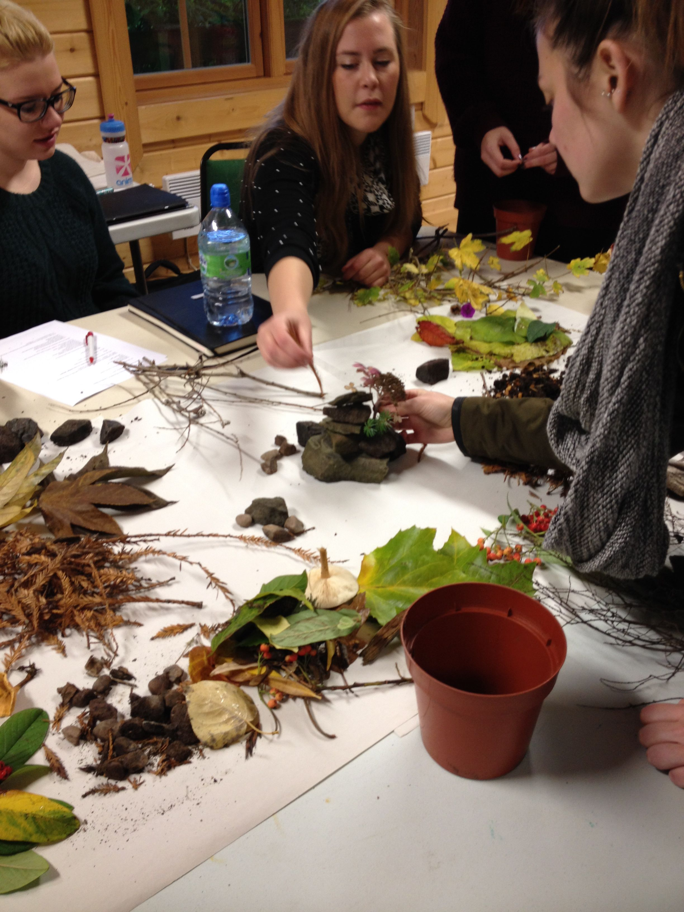
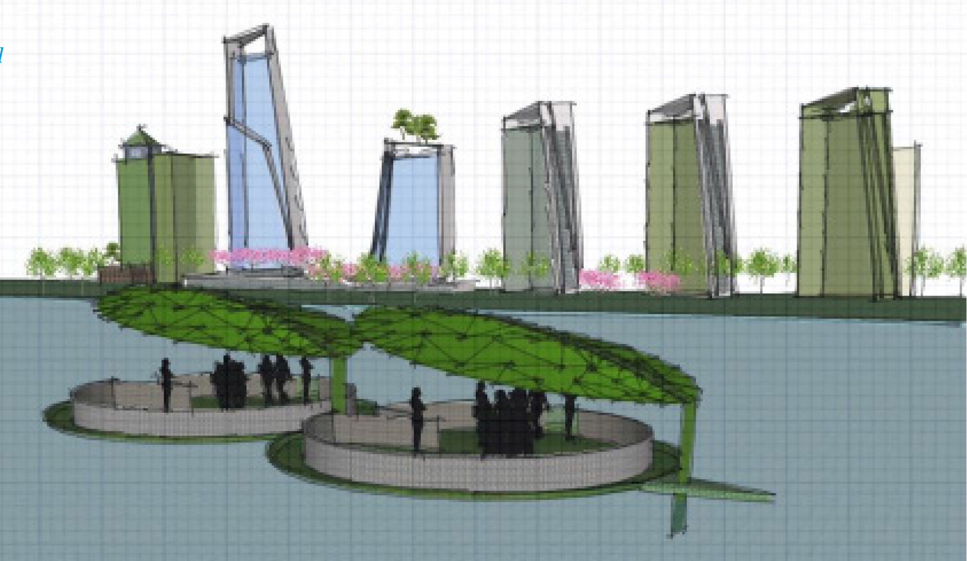
Using nature to inspire Design Values, Issues & Ethics
Jackie Malcolm j.y.malcolm@dundee.ac.uk
Duncan of Jordanstone College of Art & Design at the University of Dundee

Slide 2
Using nature to inspire Design Values, Issues & Ethics
‘How do we teach [our students] to love land and community when our society values such things far less than it does individualism and consumption?’
Orr, David W. 1994, 2004 ed. Earth in Mind: On education, Environment, and the Human Prospect. Island Press, Washington.

Slide 3
Using nature to inspire Design Values, Issues & Ethics
Design Values, Issues & Ethics
Level 3 Expansive module (optional)
Interdisciplinary: Fine Art, Jewellery & Metal Design, Interior & Environmental Design, Illustration, Graphic Design, Textiles, Interactive Media Design & Product Design.
Higher Education Academy recommendations (2009)
UN Decade of Education for Sustainable Development:
Strategic Goals for ‘reforming education’.

Slide 4
Using nature to inspire Design Values, Issues & Ethics
Aims & Objectives
To promote an awareness of the role of design values, issues and ethics within the context of 21st century design.
To introduce tools and techniques that enable participation in a sustainable and ethical design practice.
To promote the investigation of emerging activity where design thinkers are agents for change, to sustain and maintain human well-being.
To introduce design values and ethical issues through creative practice.

Slide 5
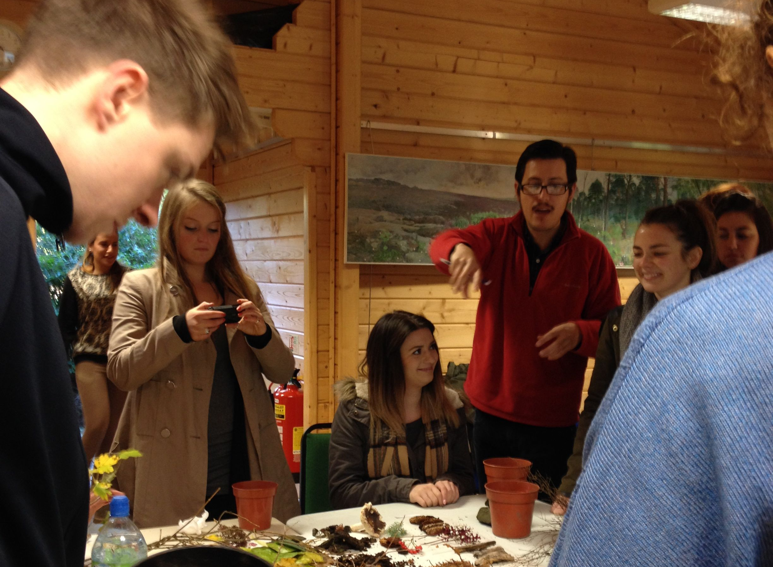
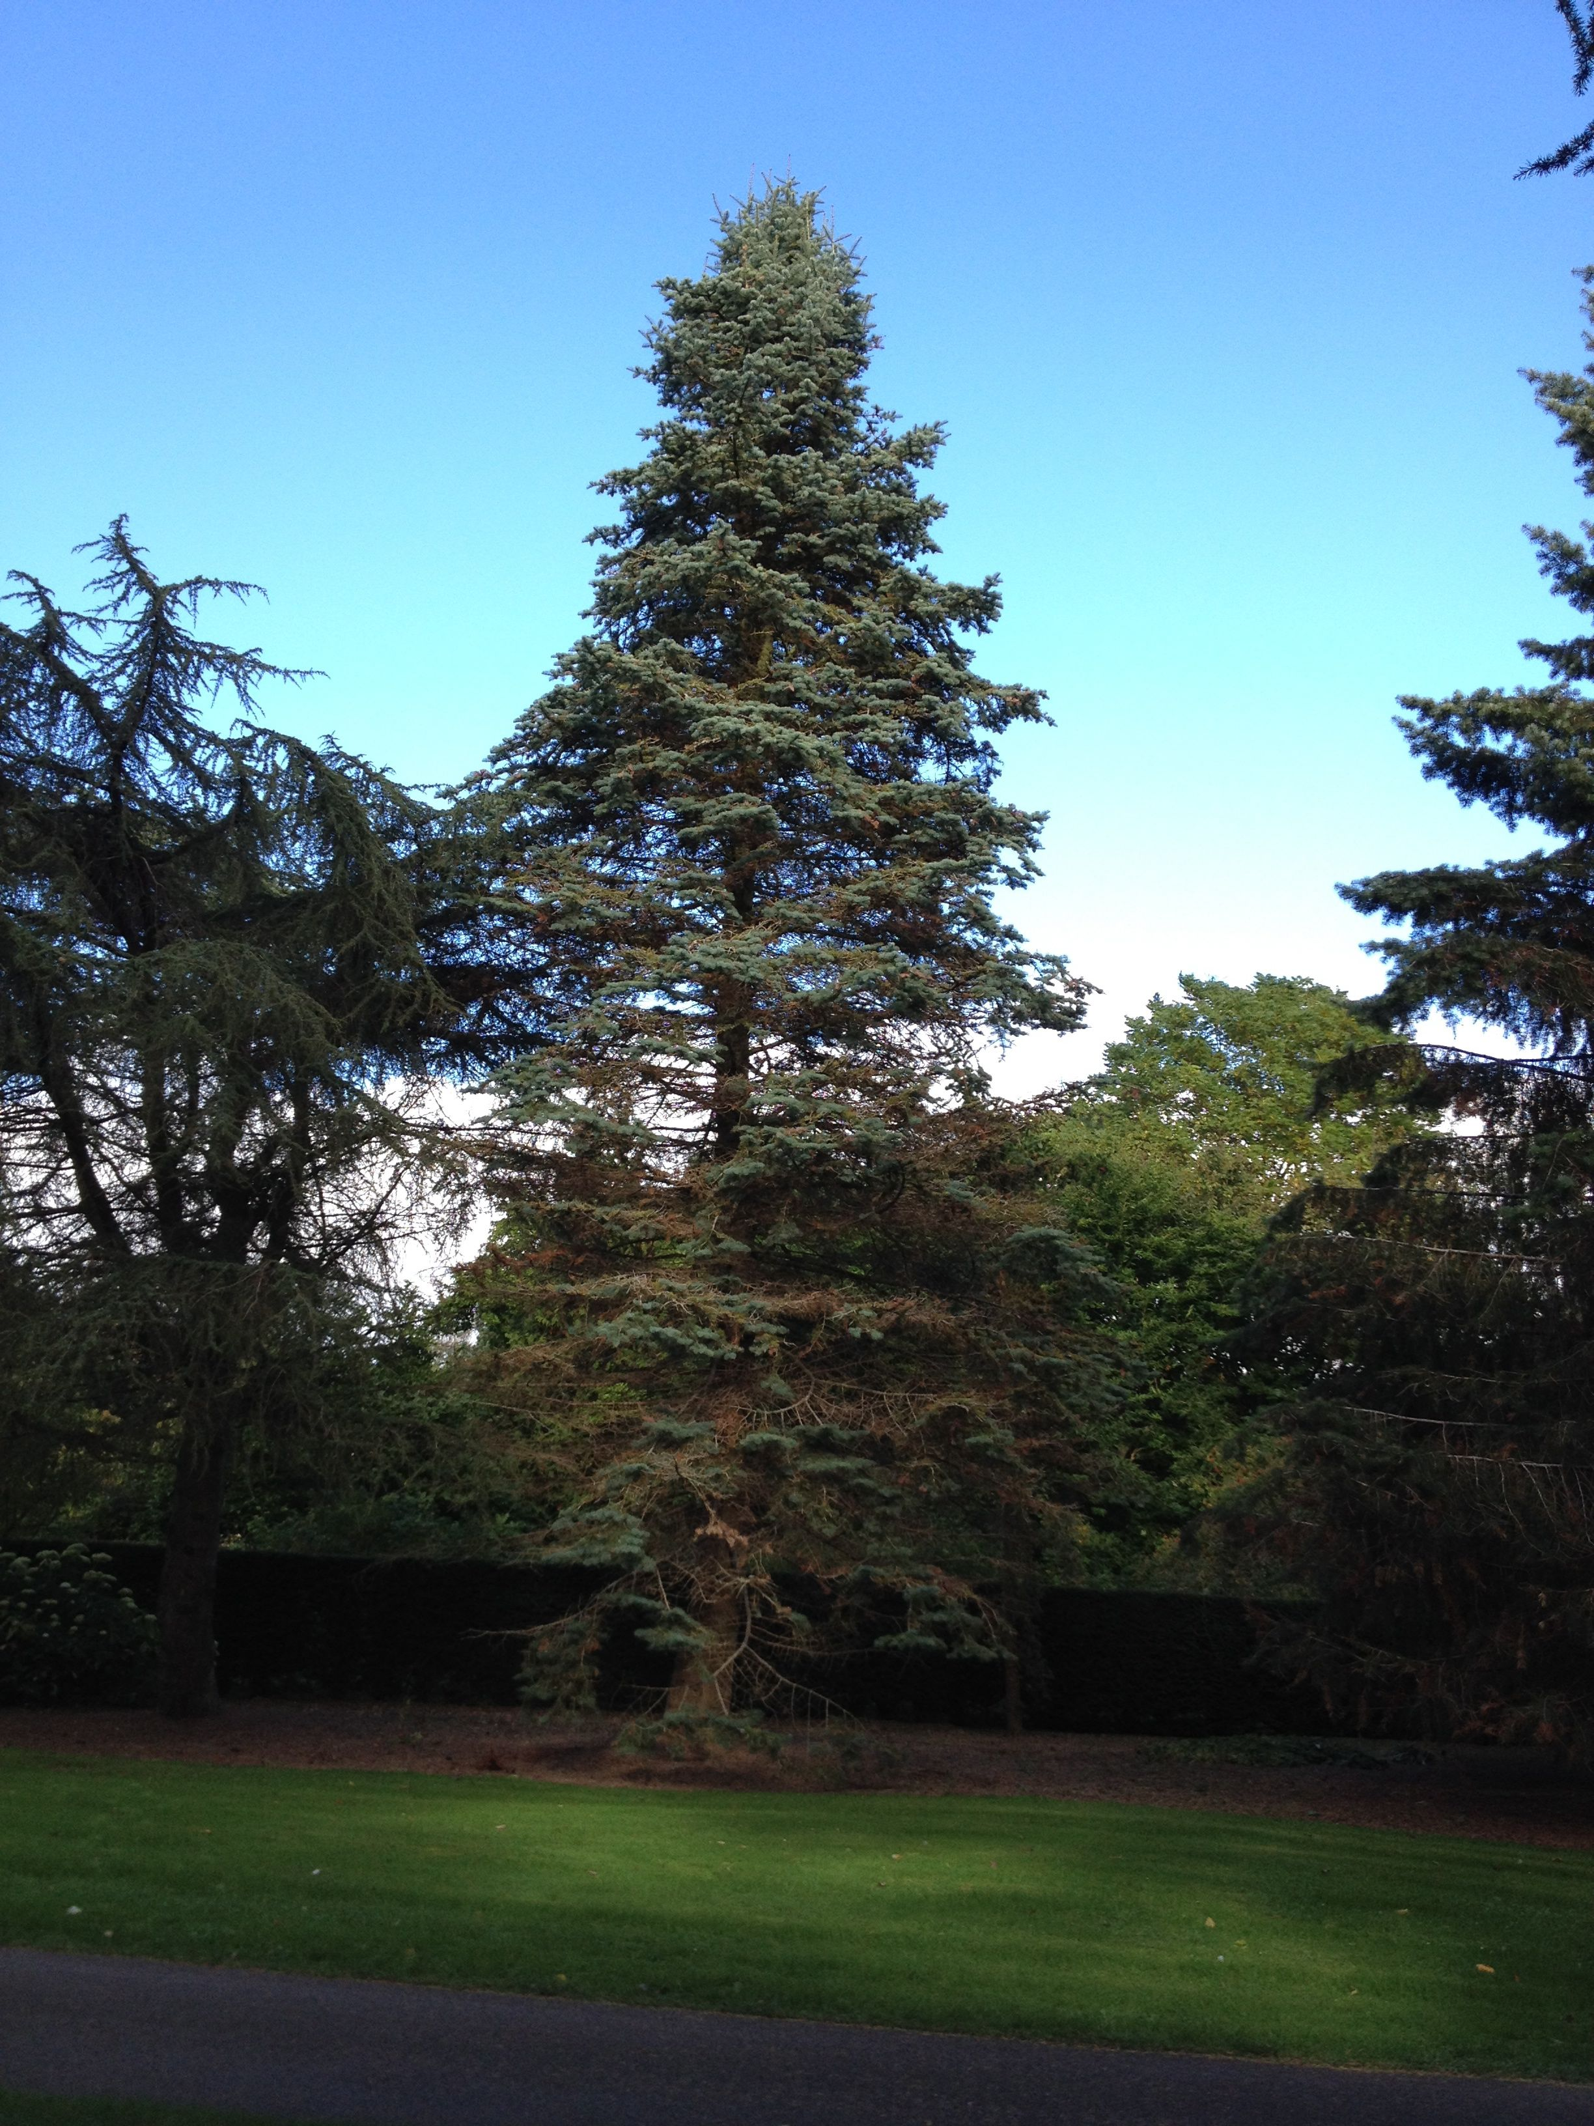
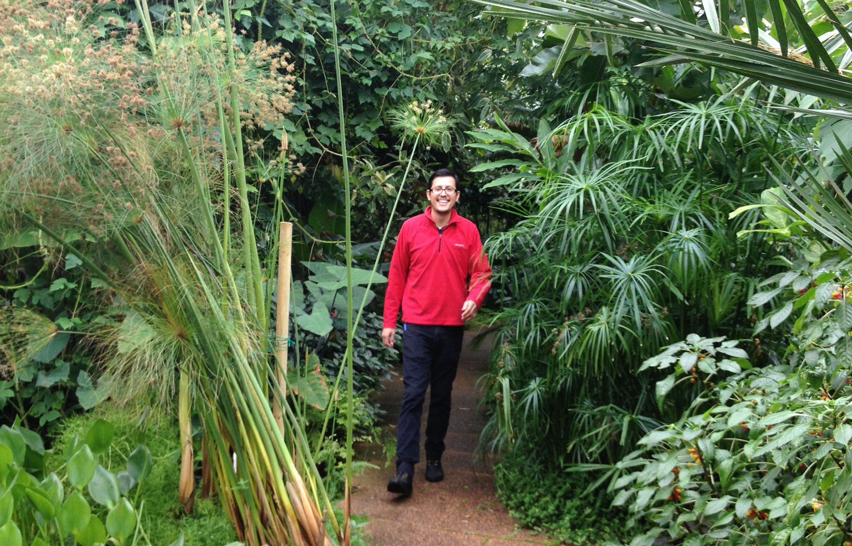
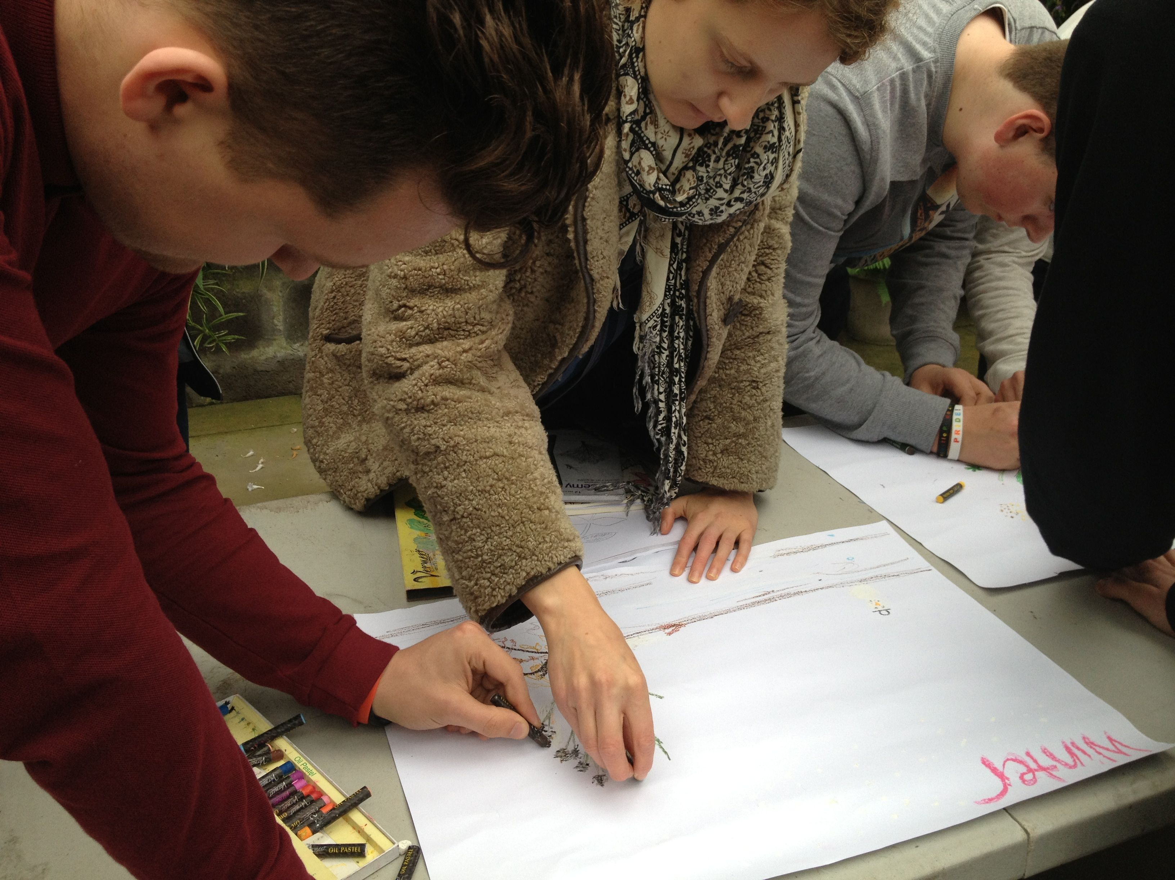
Using nature to inspire Design Values, Issues & Ethics
What did we want to know?
Can nature be a catalyst for a more ethical design practice?
Could reflexivity facilitate ‘Self-realisation’ within the student?

Slide 6
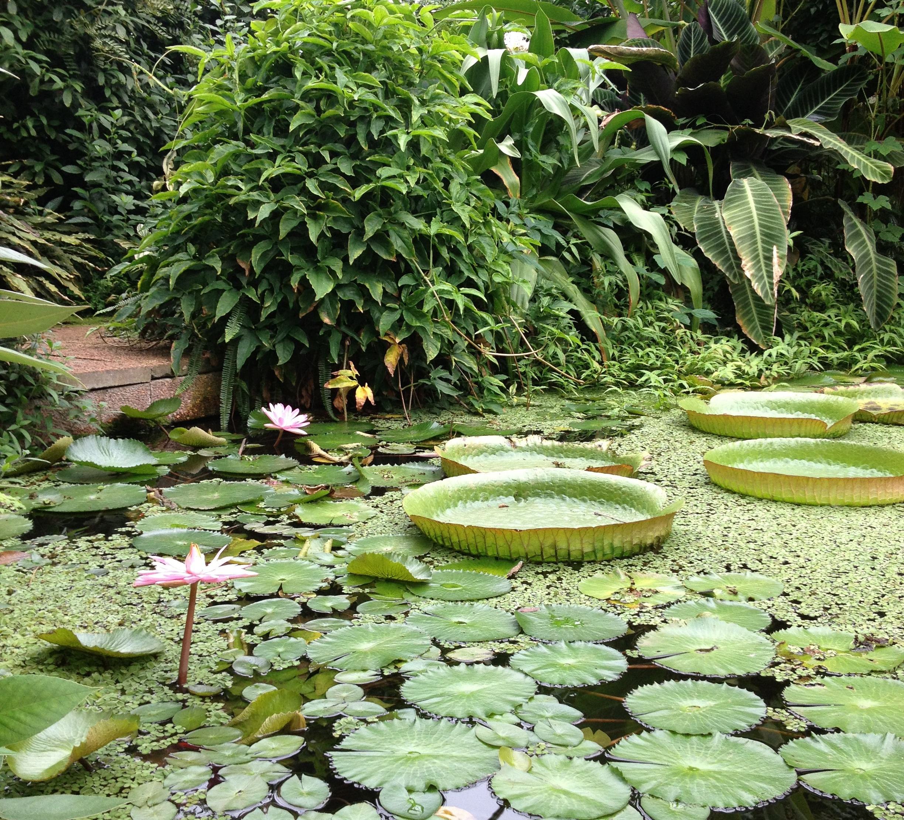
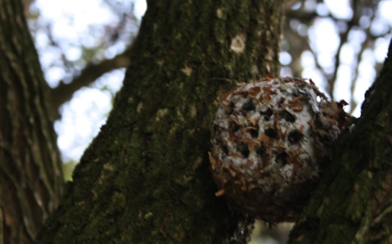
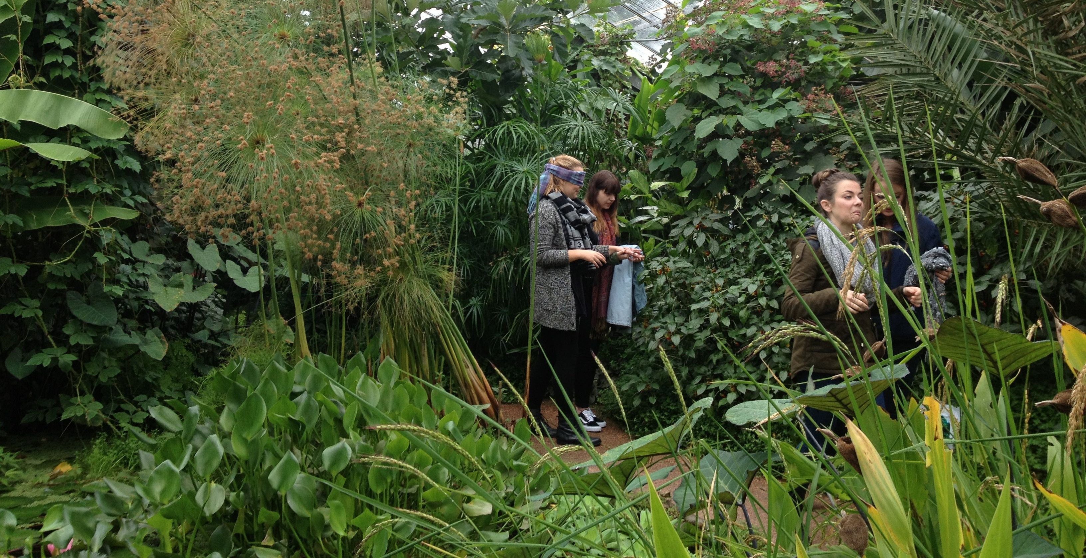
Using nature to inspire Design Values, Issues & Ethics
A Symbiotic Methodology
91 students over 4 years
15 year one, 25 year two, 23 year three, 28 year four
PhD student David Sanchez
4 workshops: Biophilia, Biomimicry, Resilience, Symbiosis
3 levels of data: Project submissions, Reflective articles and Module evaluation

Slide 7
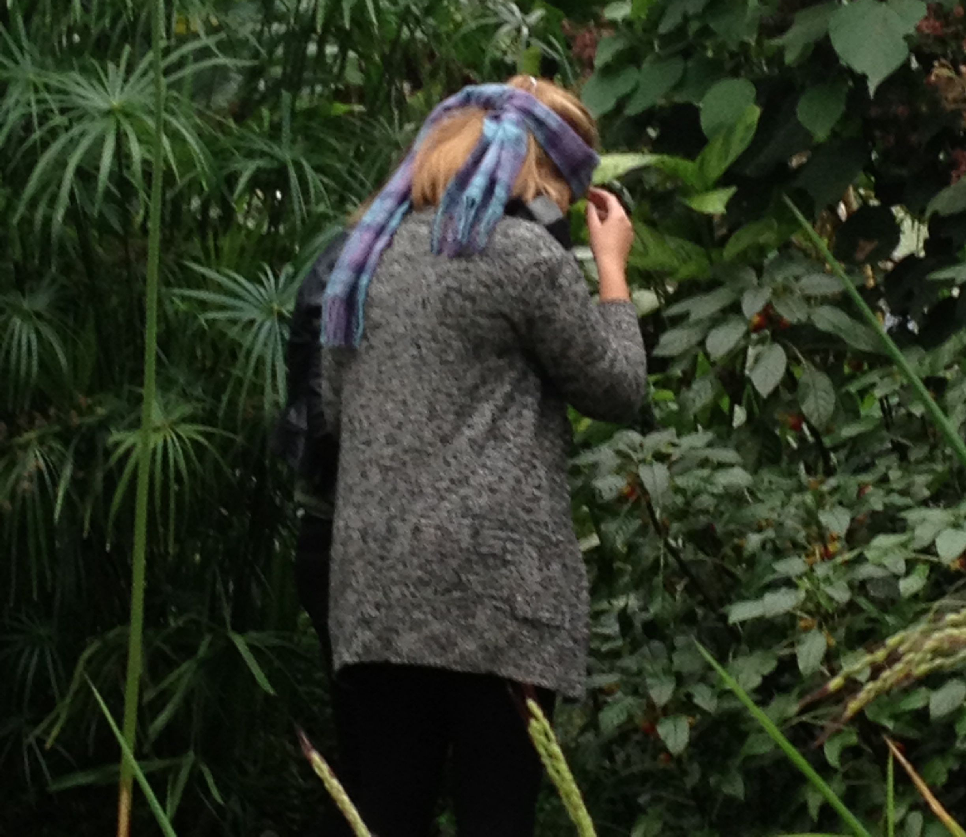
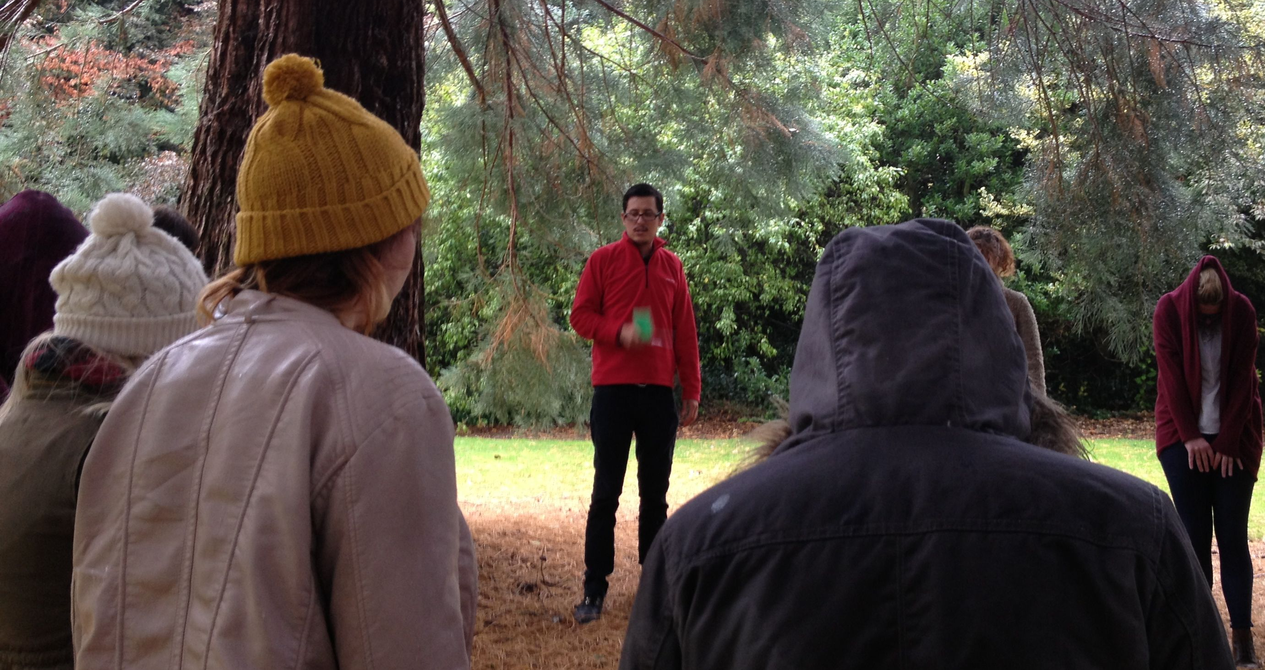
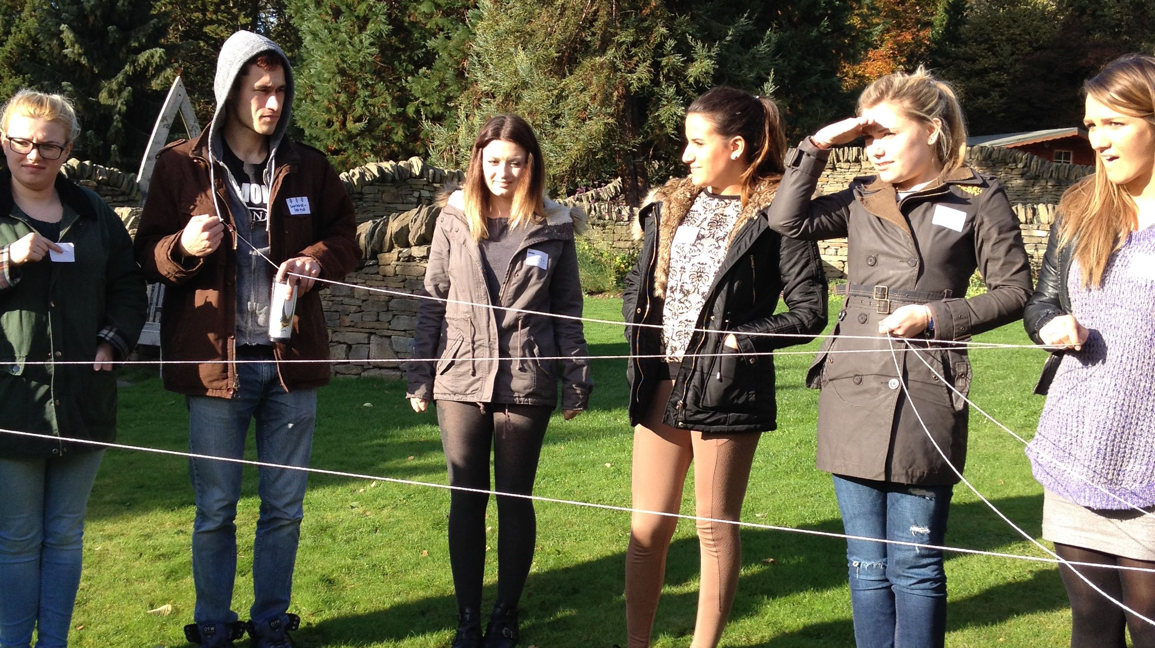
Using nature to inspire Design Values, Issues & Ethics
Biophilia – engaging with nature
Stimulating the senses – ‘instinct’
Promote Biophilic values
Recognise Biophilia as the first step in the pursuit of design ethics
Self-realisation

Slide 8
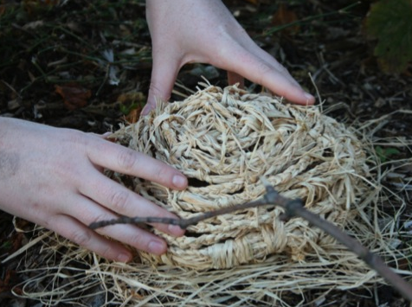
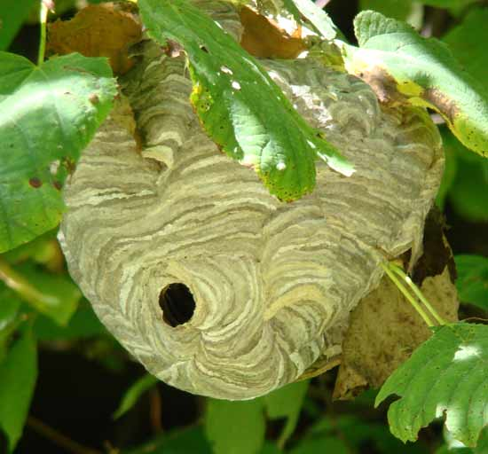
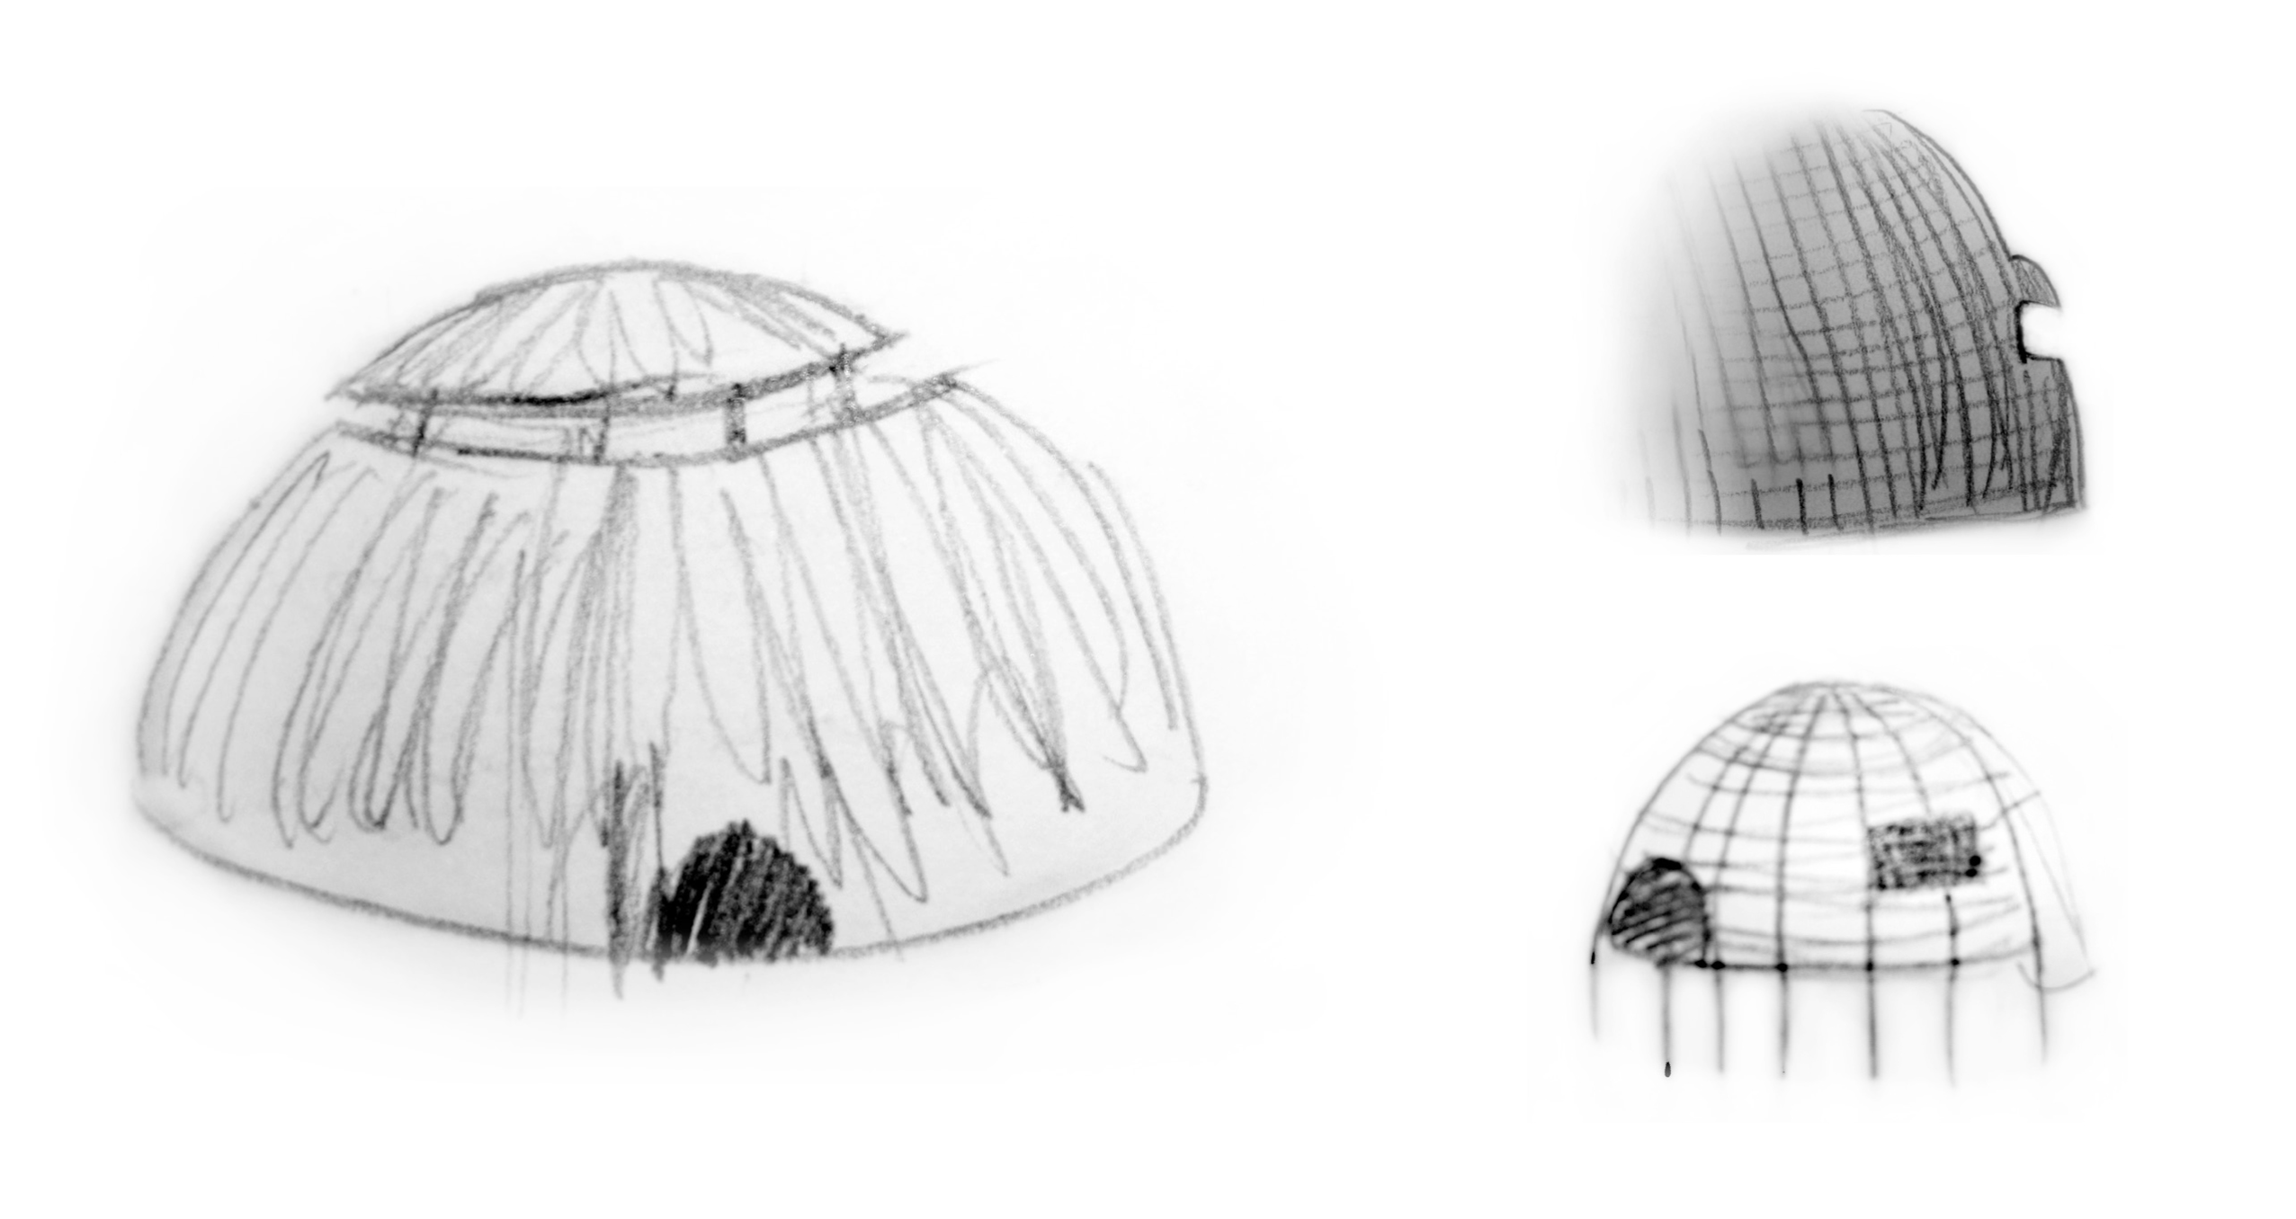
Using nature to inspire Design Values, Issues & Ethics
Biomimicry – designing with nature
Identify Biomimicry as a tool to achieve ecological design innovation
Cultivate creative inspiration and meaningful strategies
Deepen an awareness of ecological intelligence
Collective realisation

Slide 9
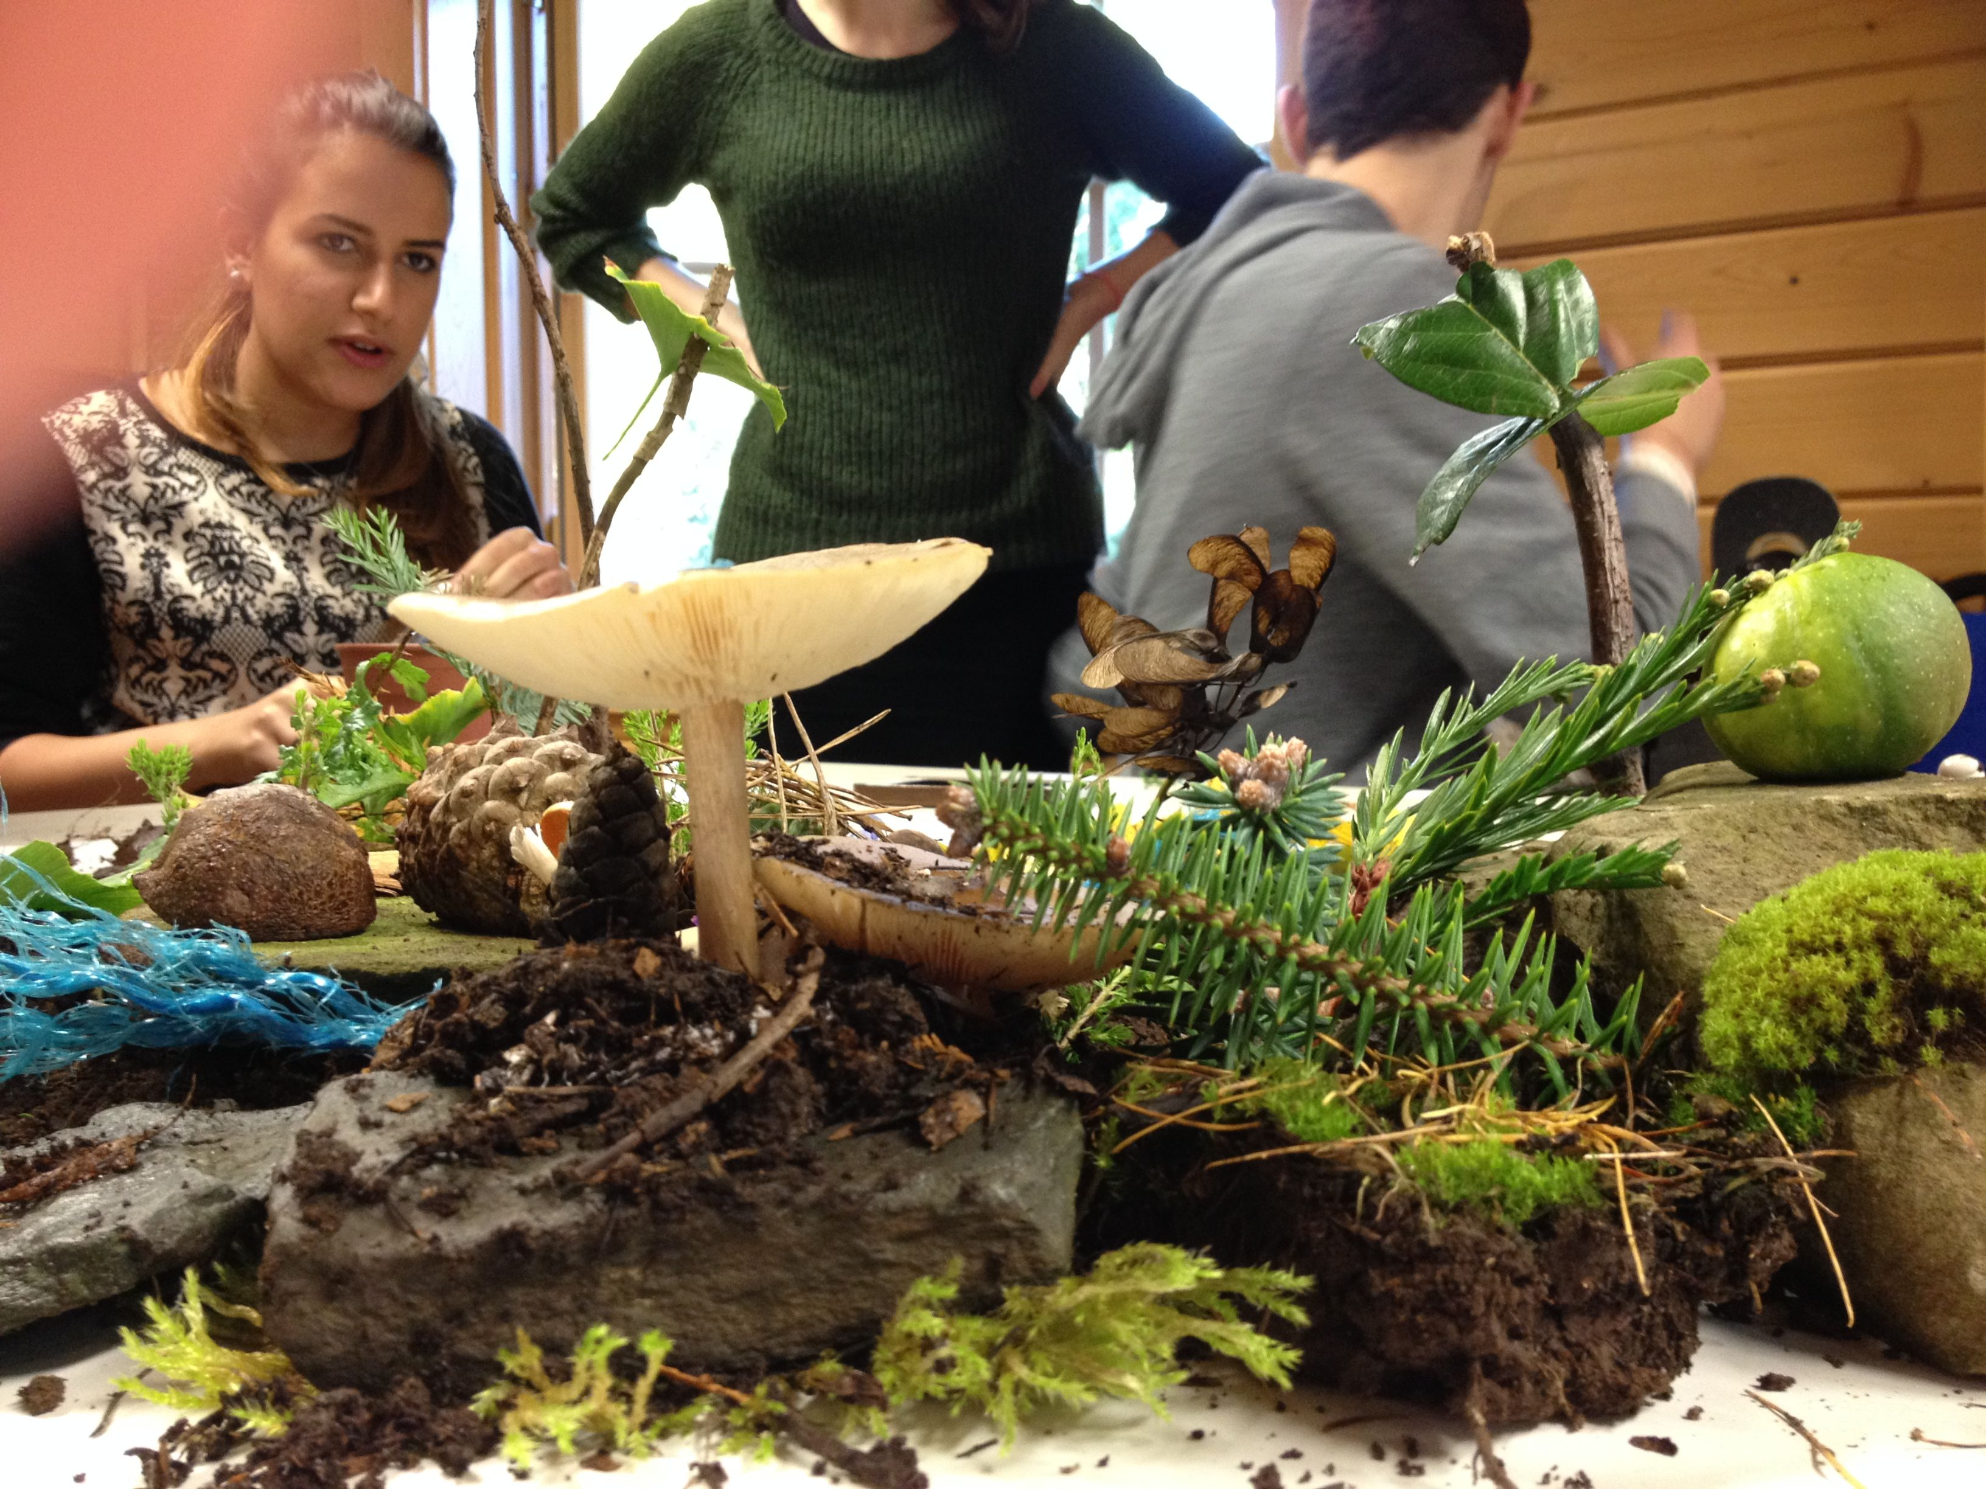
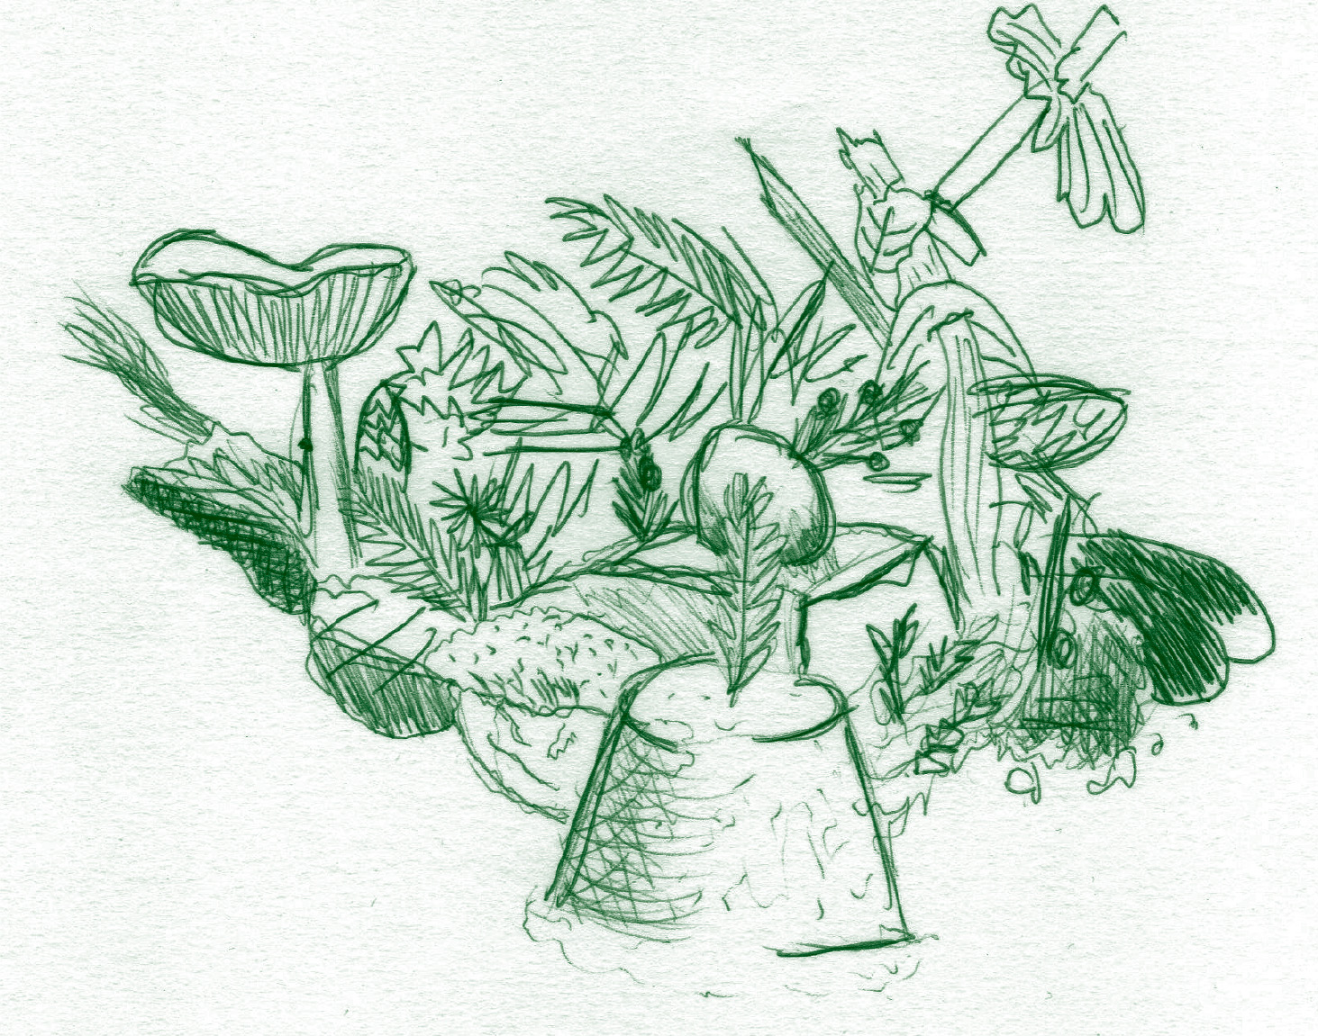
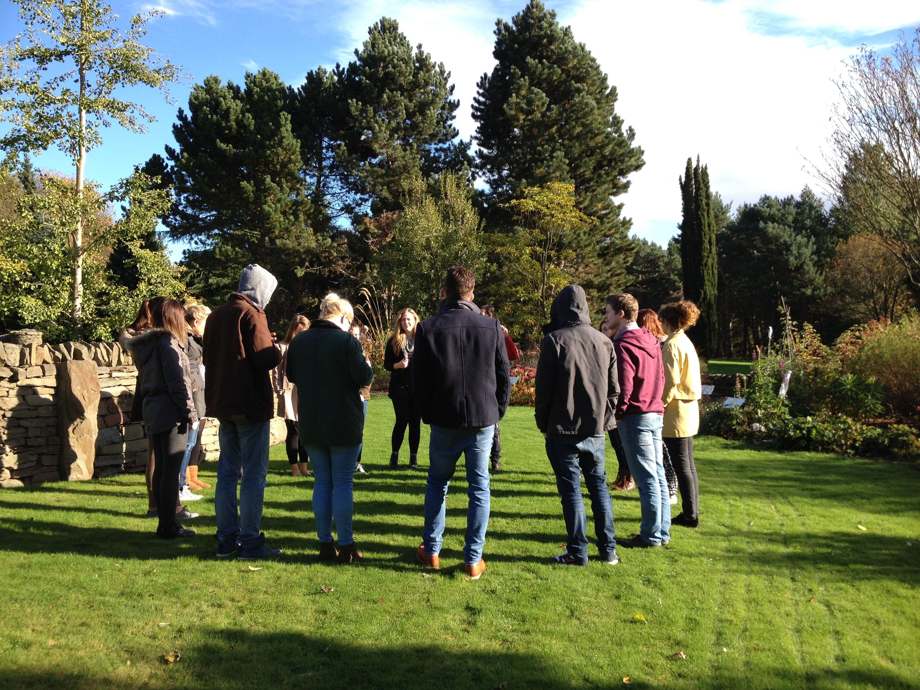
Using nature to inspire Design Values, Issues & Ethics
Resilience – change with nature
• Respond to unexpected events
• Recognise that systems can adapt and change
• Community – concept of community both human and ecological
• Planetary ethics

Slide 10
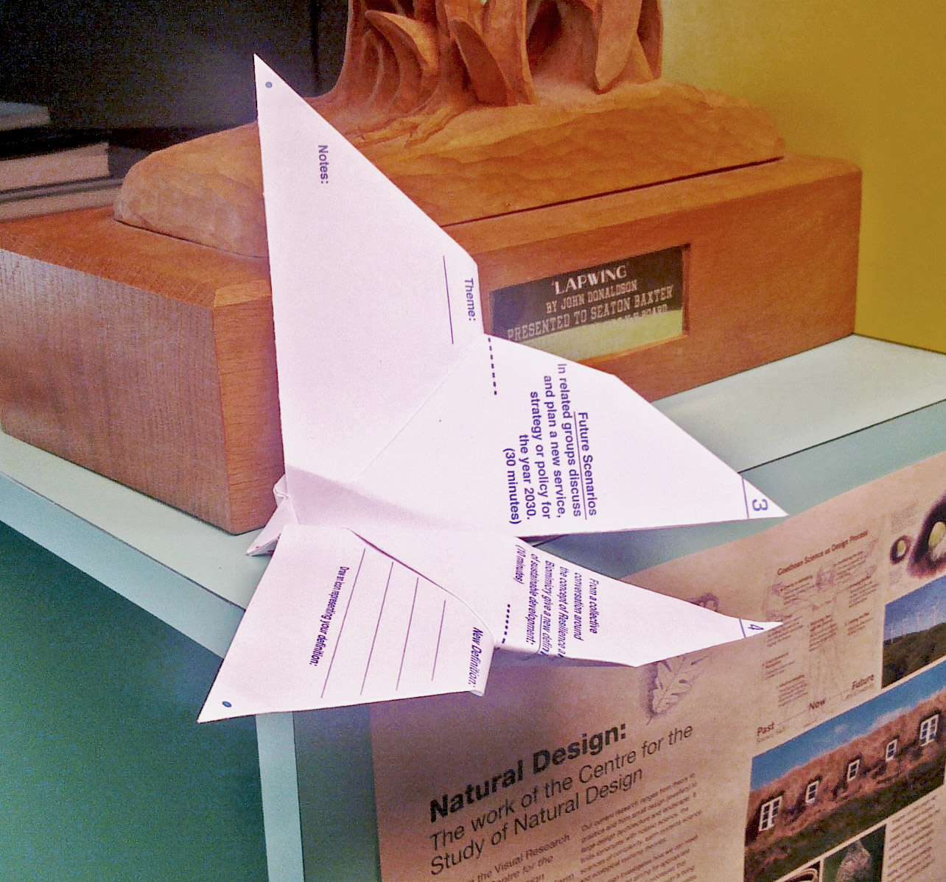
Using nature to inspire Design Values, Issues & Ethics
Symbiosis – transcend with nature
• design intention
• holistic level

Slide 11
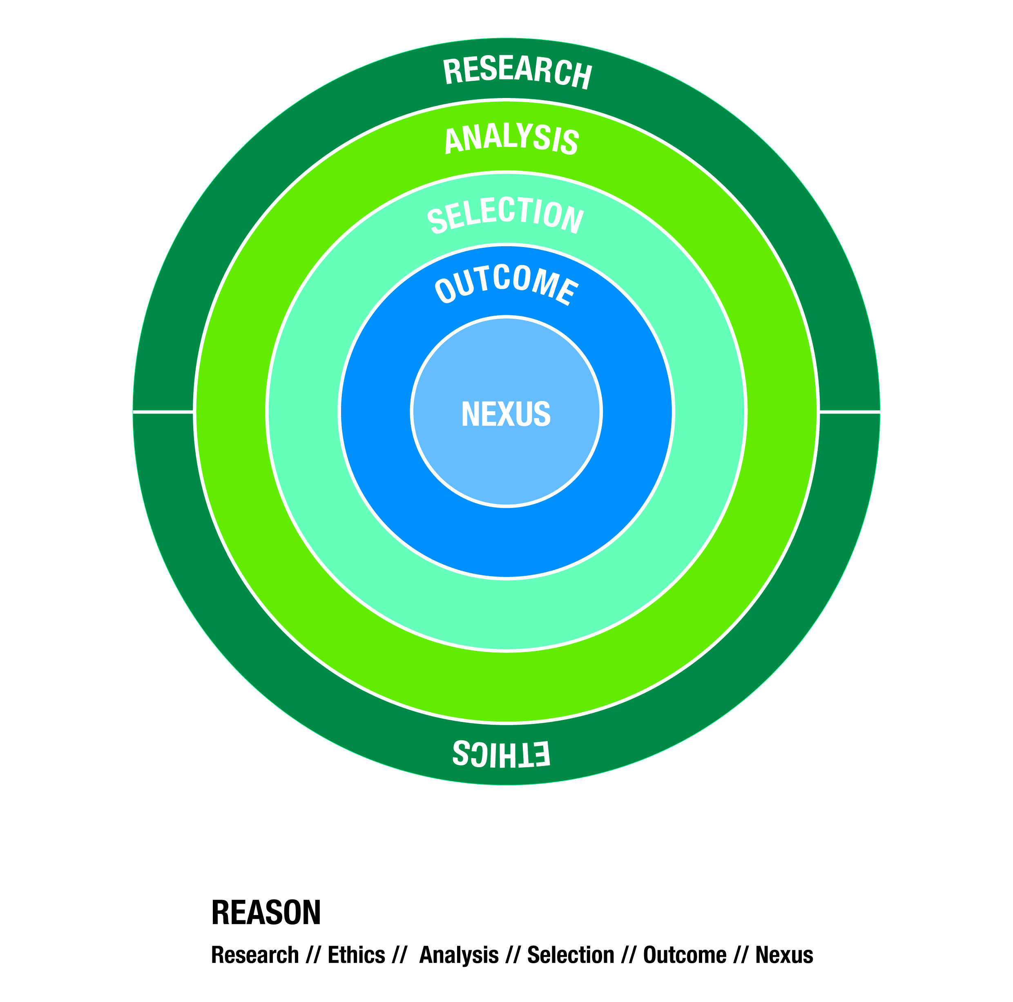
Using nature to inspire Design Values, Issues & Ethics

Slide 12
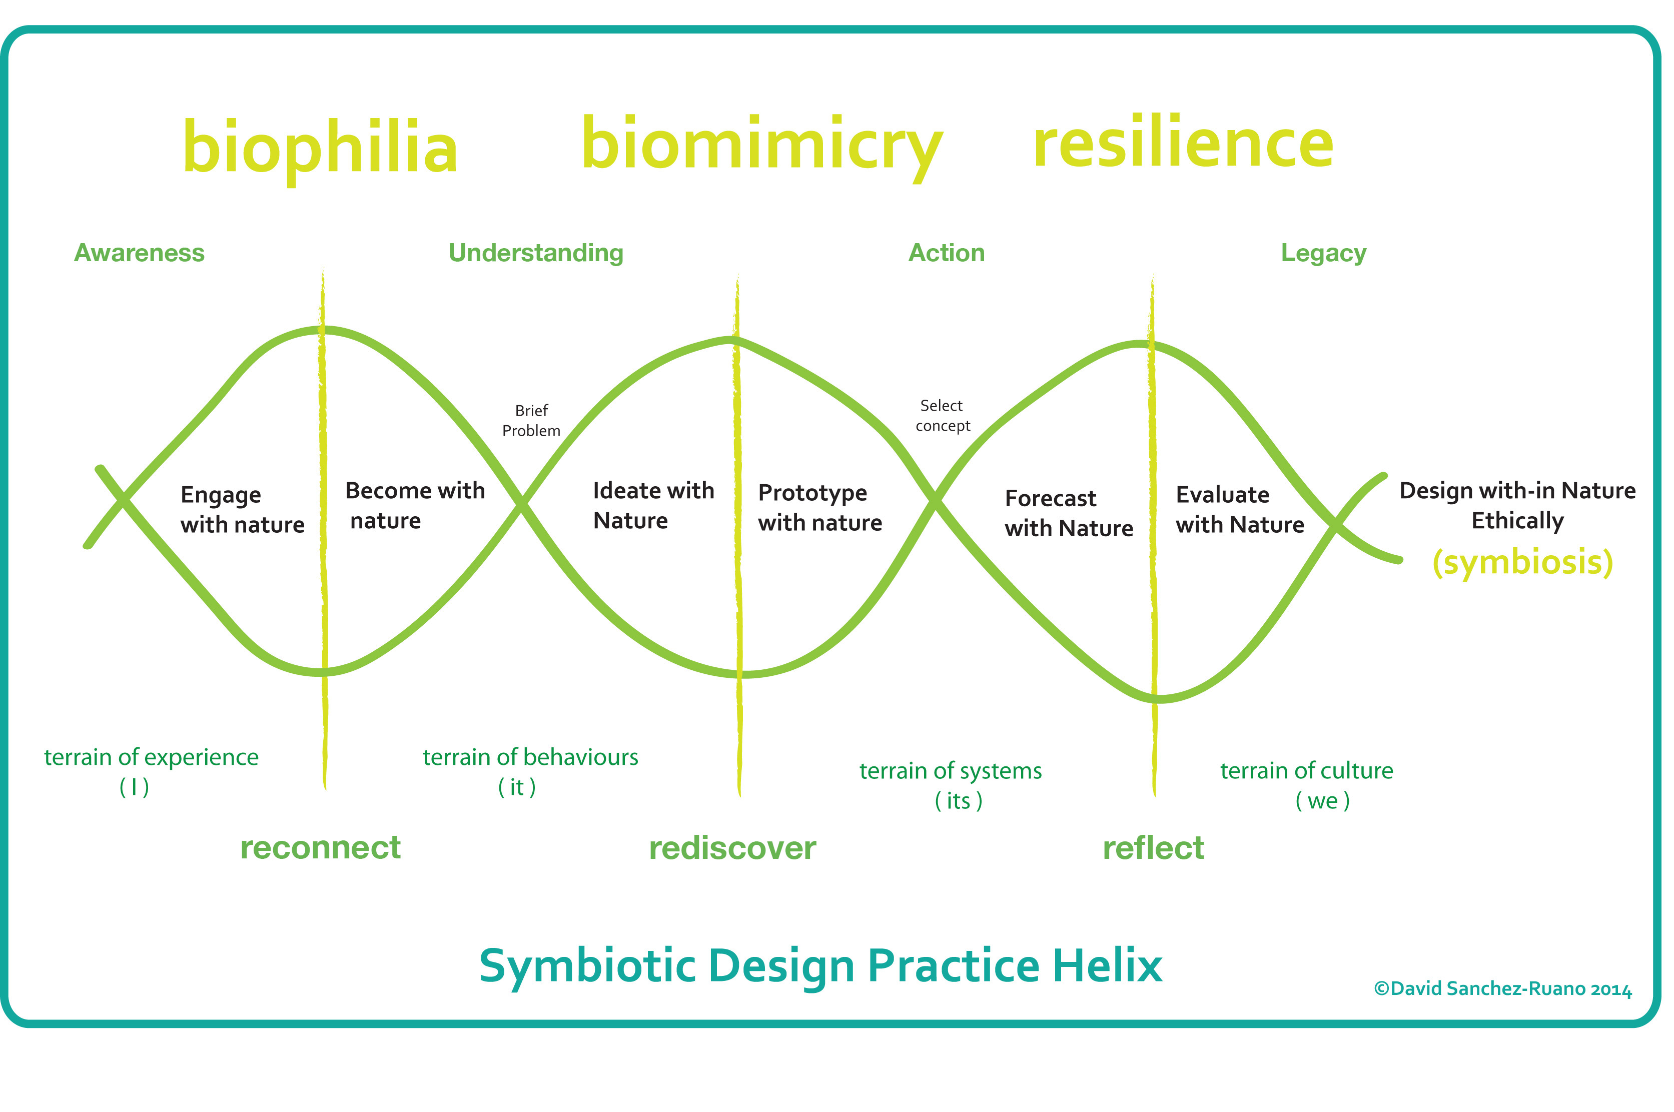
Using nature to inspire Design Values, Issues & Ethics

Slide 13
Using nature to inspire Design Values, Issues & Ethics
Ethics
• Living Principles, Life’s Principles, Cradle to Cradle
• Sustainable does not mean ethical
• Duality of ‘Ethics’ and ‘Self’ is reflexive
• Move towards ‘Self-realisation’ Arne Naess

Slide 14
Using nature to inspire Design Values, Issues & Ethics

Slide 15
Using nature to inspire Design Values, Issues & Ethics
Evaluating the Student Experience
Practical Project – Interdisciplinary Group
Reflective Article – How to Design a Community
Module Evaluation

Slide 16
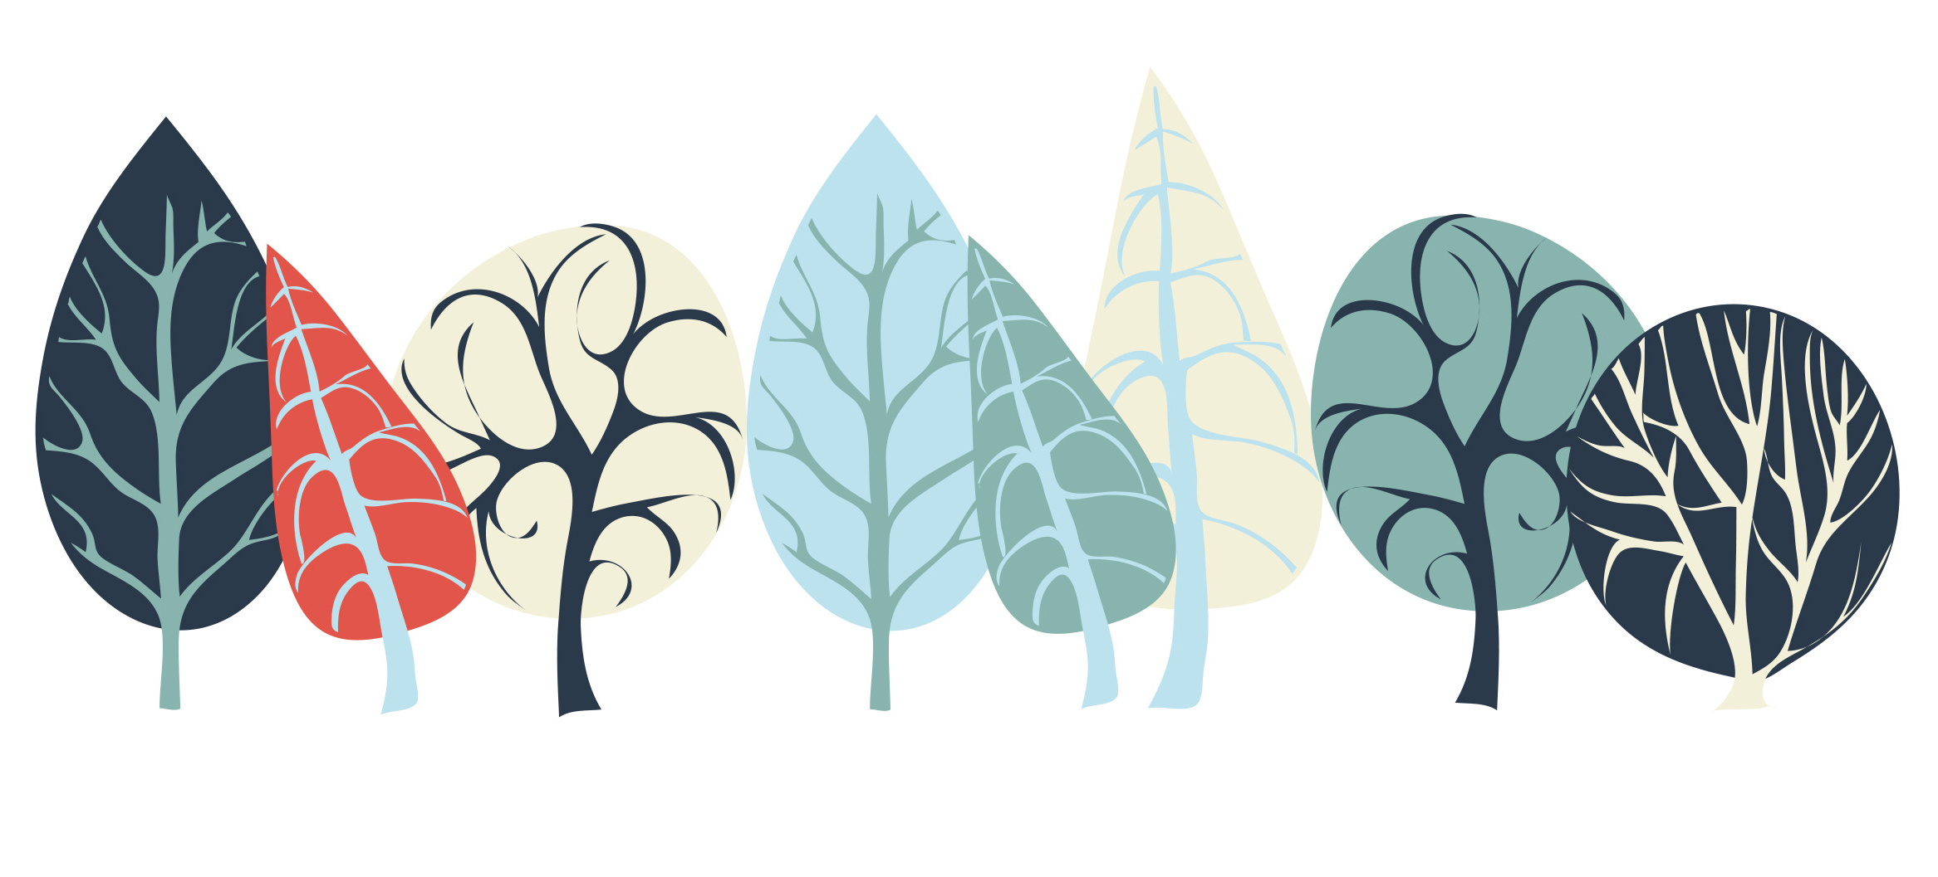
Using nature to inspire Design Values, Issues & Ethics
The Project – Design a Community
Location – University of Dundee Botanic Gardens
Housing // Health // Water // Education // Communication // Transport // Food

Slide 17
Using nature to inspire Design Values, Issues & Ethics

Slide 18
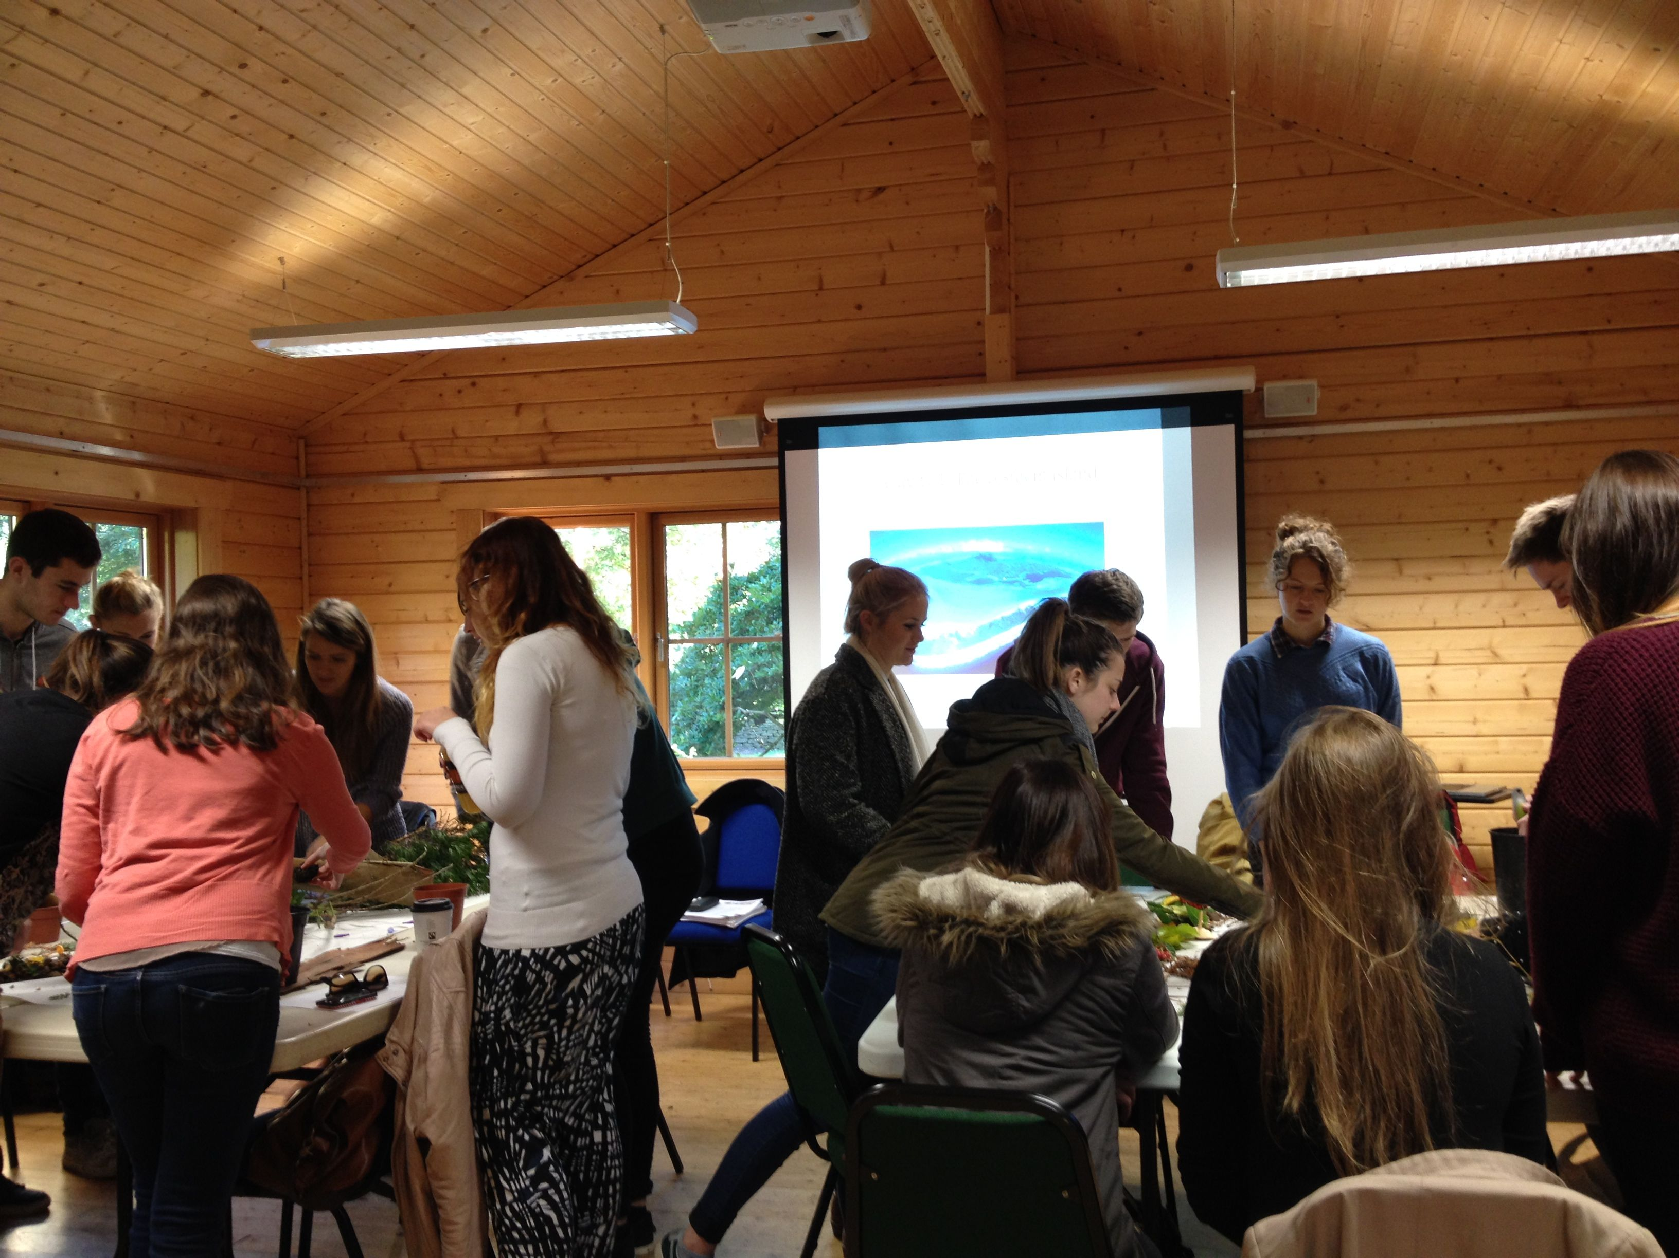
Using nature to inspire Design Values, Issues & Ethics

Slide 19
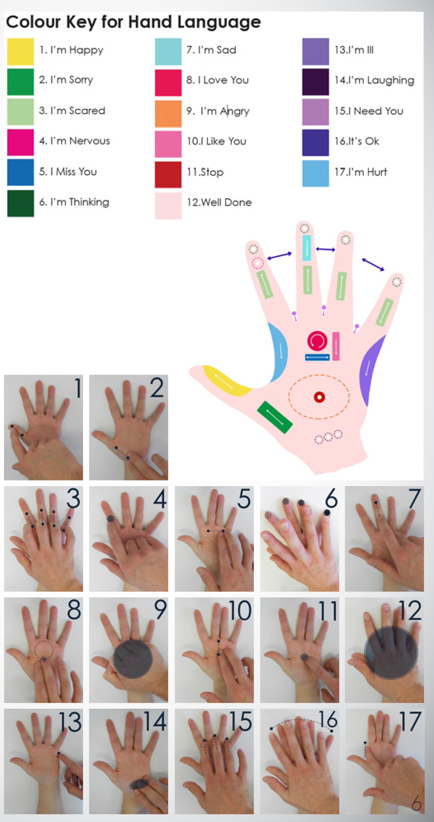
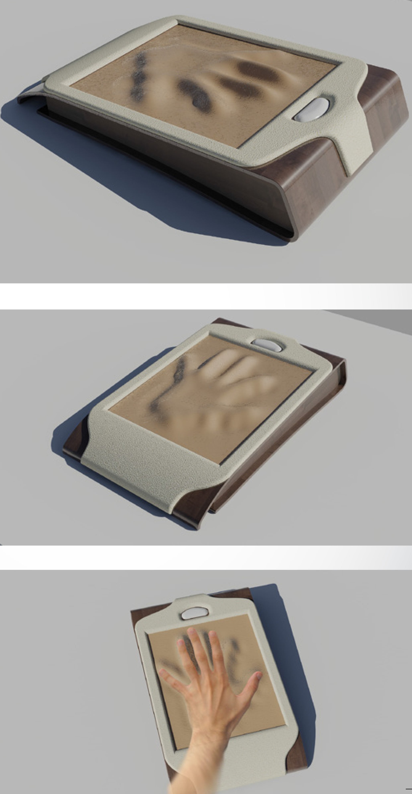
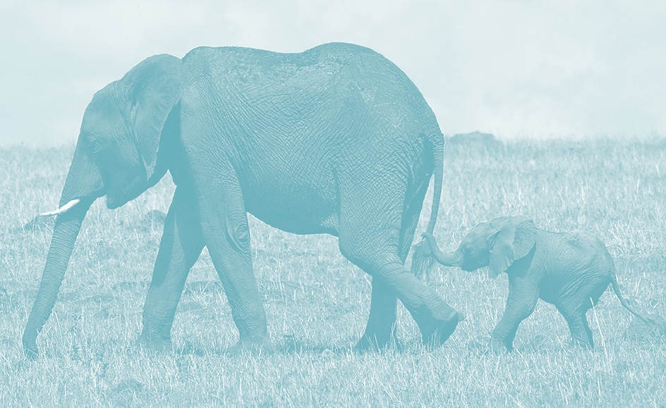
Using nature to inspire Design Values, Issues & Ethics
Communication
Inspiration - Elephants & touch

Slide 20
Using nature to inspire Design Values, Issues & Ethics
Communication
Inspiration – Vampire Bats,
Capuchin Monkeys, Pitcher Plant

Slide 21
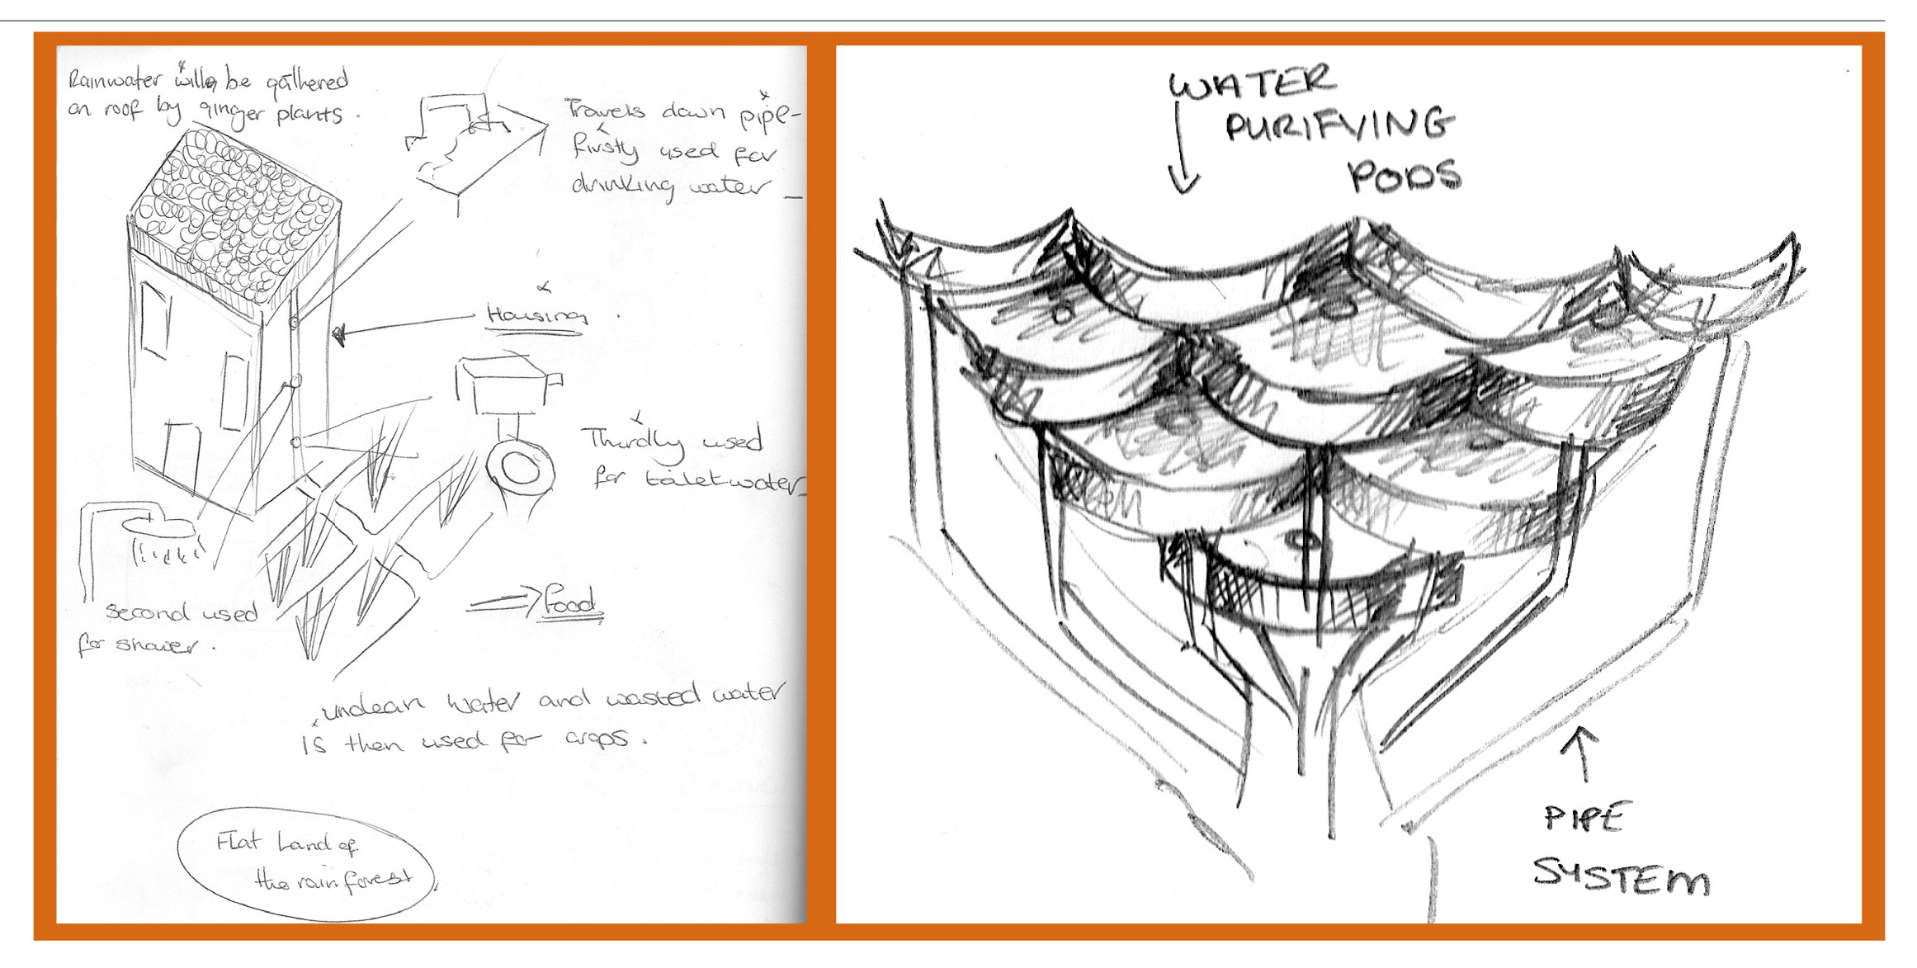
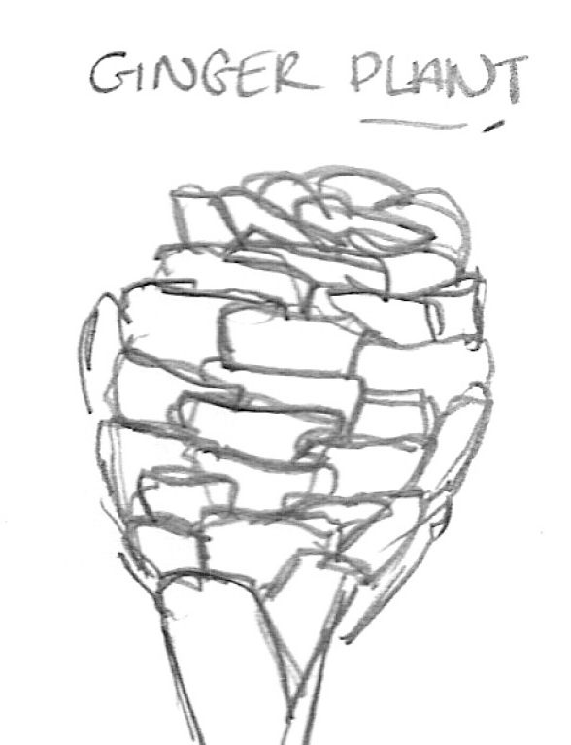
Using nature to inspire Design Values, Issues & Ethics
Water – Zingiber Community
Inspiration – Ginger Plant, Namib Beetle, Reverse Osmosis

Slide 22
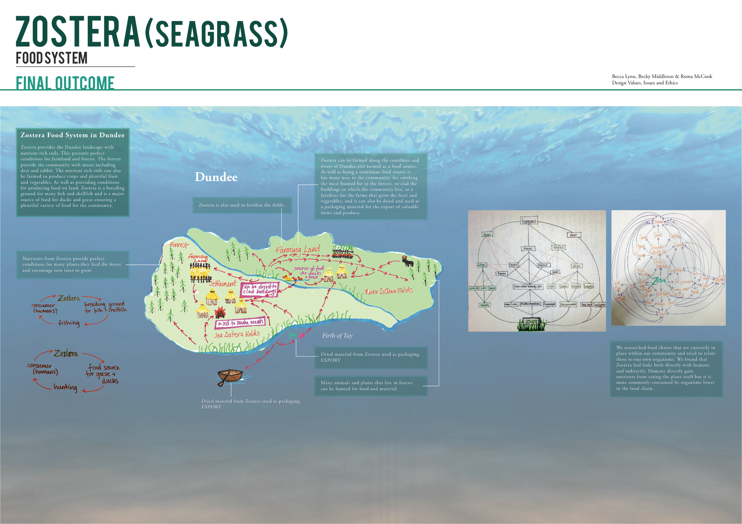
Using nature to inspire Design Values, Issues & Ethics
Food
Inspiration – Zostera Seagrass

Slide 23
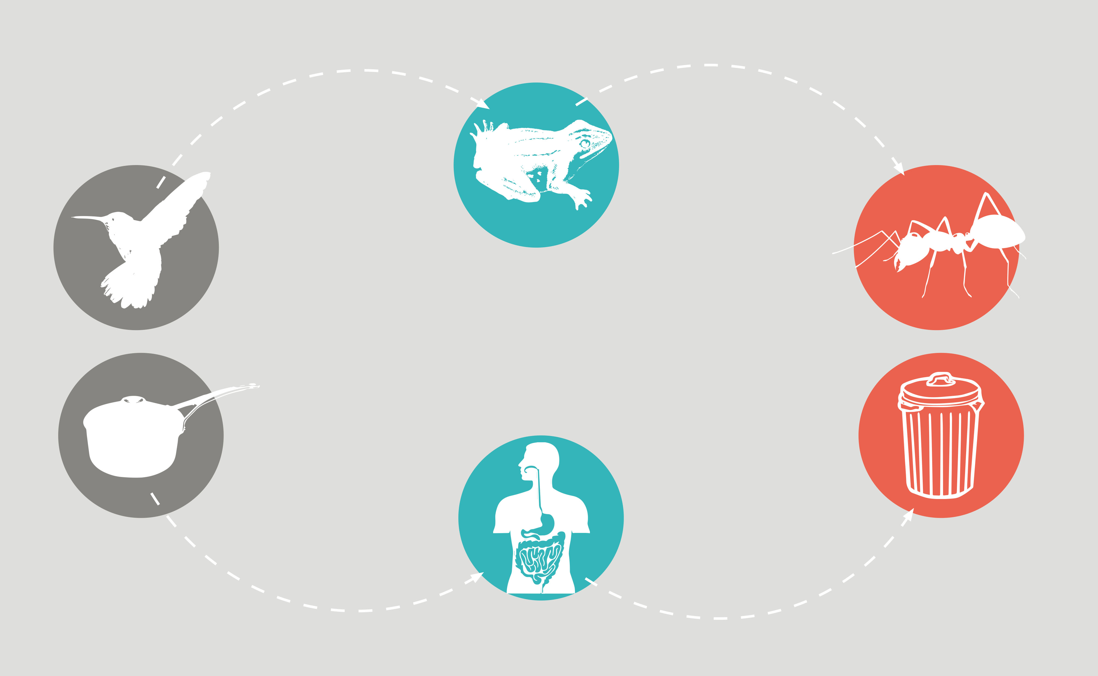
Using nature to inspire Design Values, Issues & Ethics
Health
Inspiration – Hummingbird, Glass Frog, Leaf Cutter Ant

Slide 24
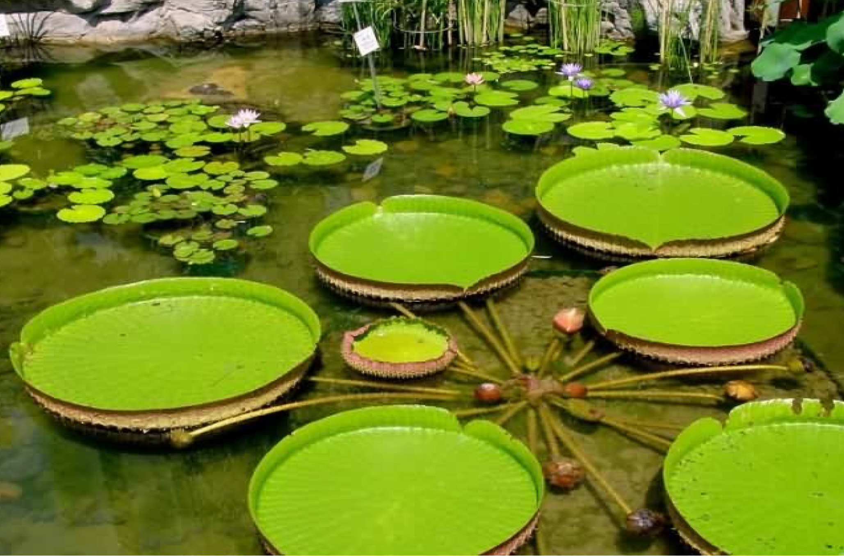
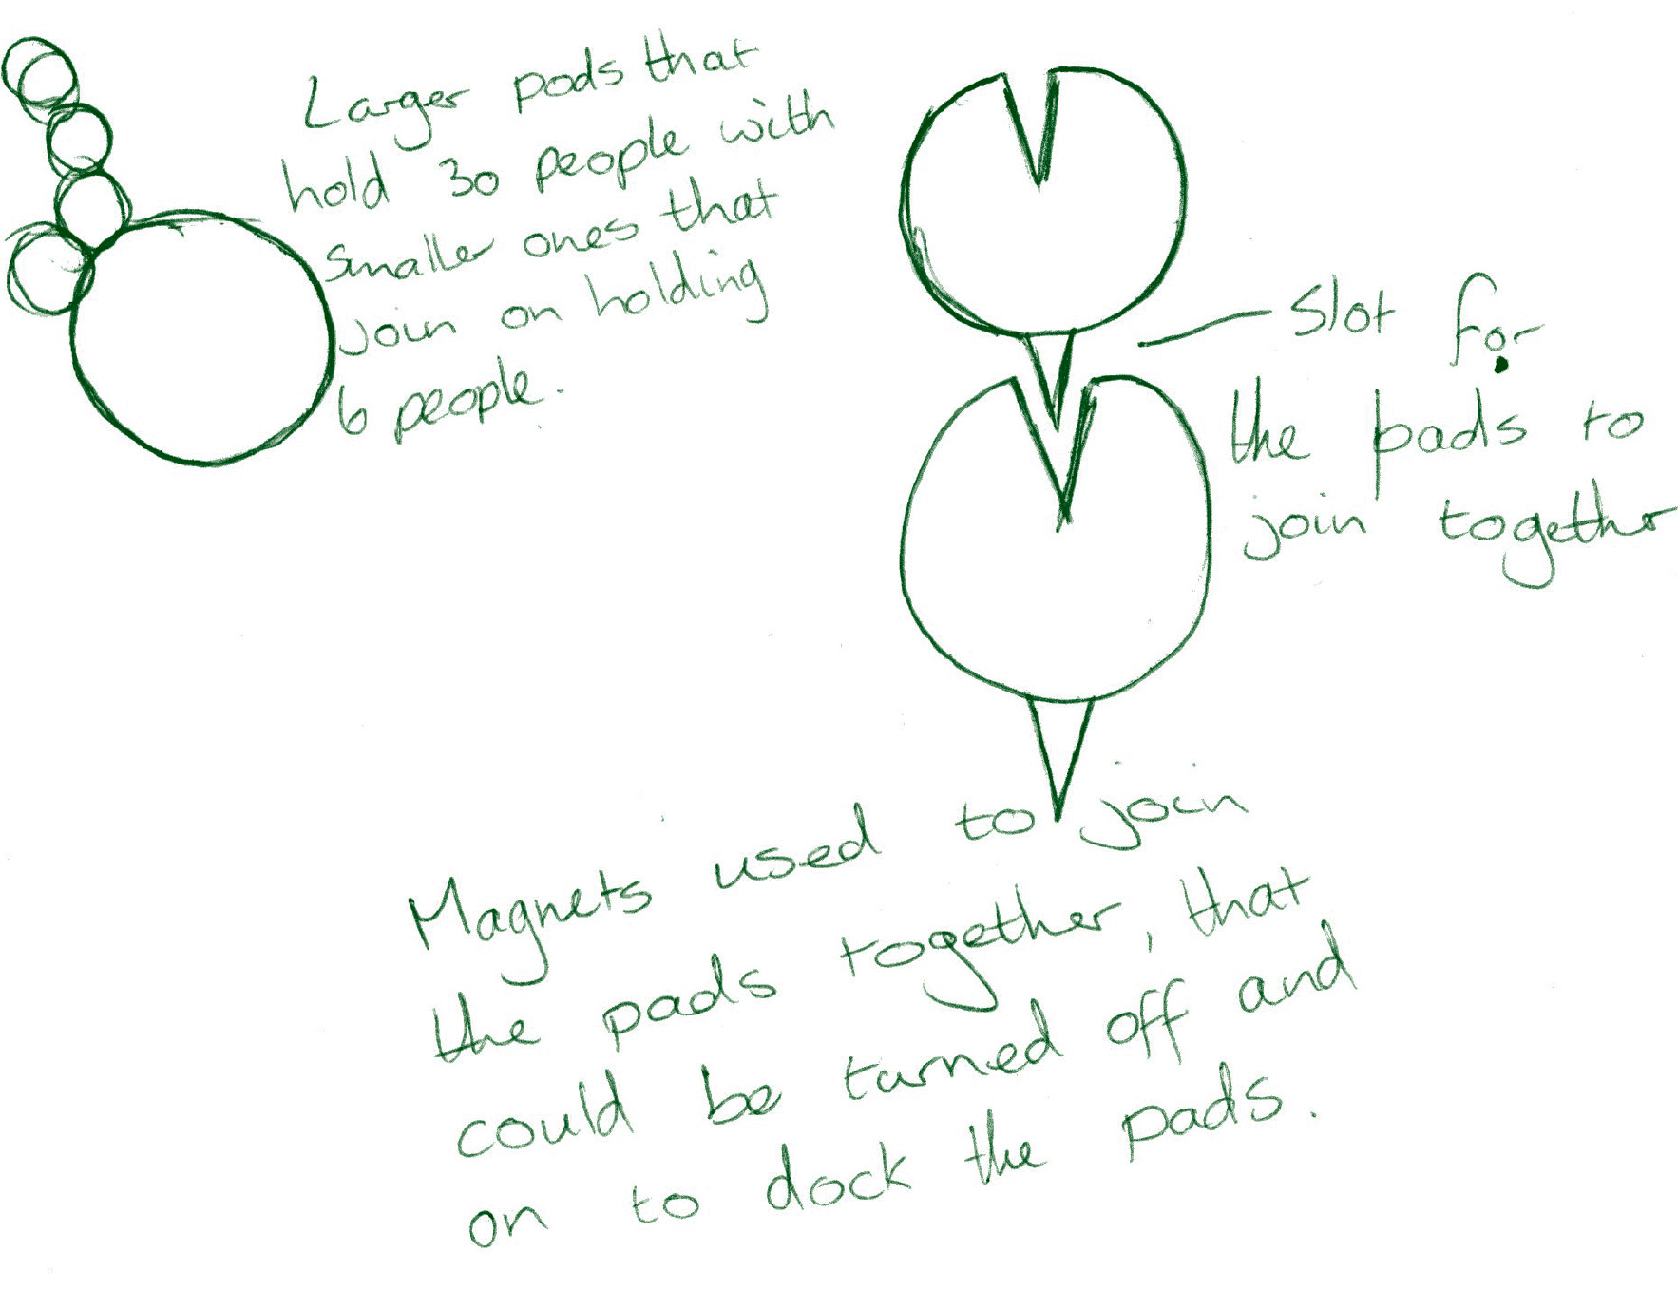
Using nature to inspire Design Values, Issues & Ethics
Transport
Inspiration – Giant Lilypads, Solar Energy,
Biofuels from Algae & Water Jets

Slide 25
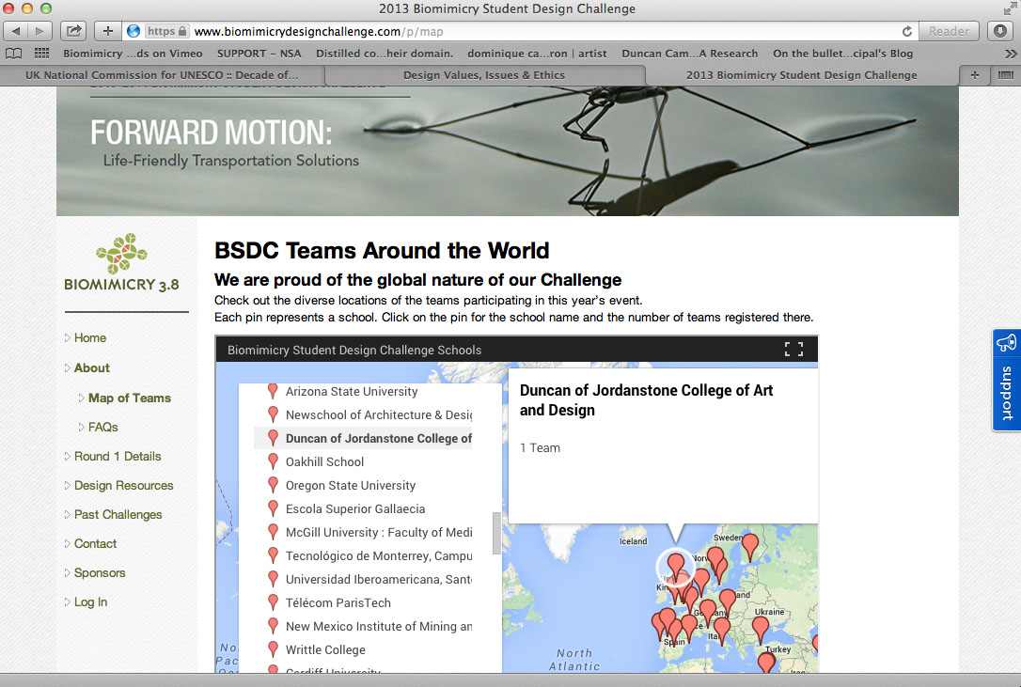
Using nature to inspire Design Values, Issues & Ethics

Slide 26
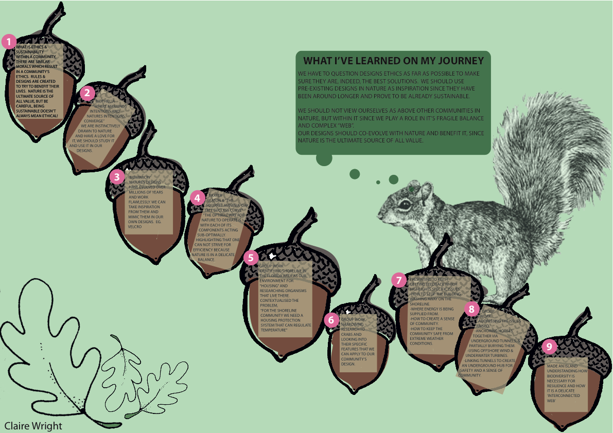
Using nature to inspire Design Values, Issues & Ethics
Learning Map

Slide 27
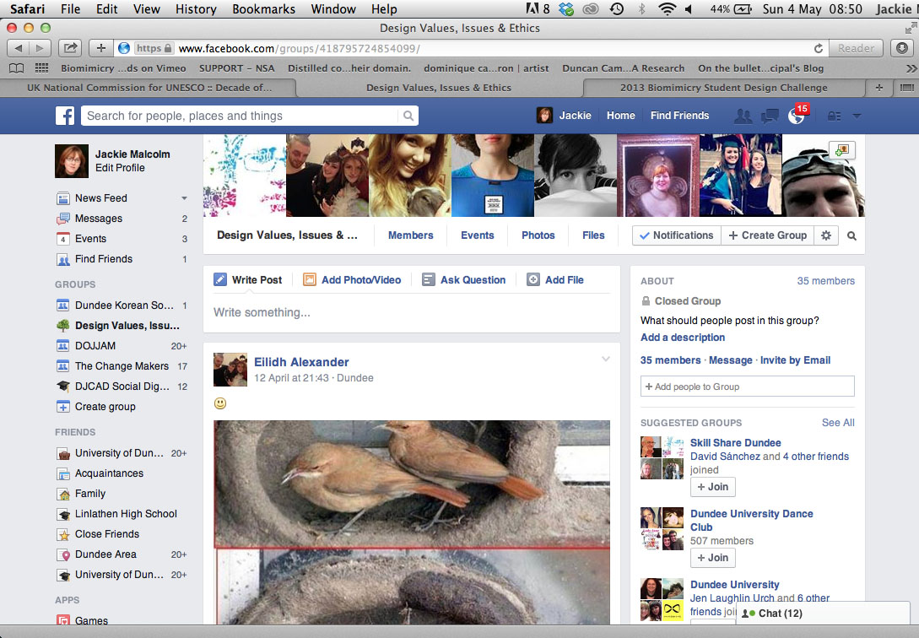
Using nature to inspire Design Values, Issues & Ethics

Slide 28
Using nature to inspire Design Values, Issues & Ethics
The Nexus – Reflexivity
Book chapters for first five weeks
• McDonough, W. Braungart, M. (2002) Cradle to Cradle: Remaking the Way
we Make Things. North Point Press.
• Curry, P. (2006) Ecological Ethics. Polity Press.
• Walker, S. (2006) Sustainable by Design: Explorations in Theory and Practice. Earthscan.
• Orr, D. W. (2002) Nature of Design : Ecology, Culture, and Human Intention.
Oxford University Press.
• Skene, K. (2009) Escape from Bubbleworld: Seven Curves to Save the Earth.
Ard Macha Press.

Slide 29
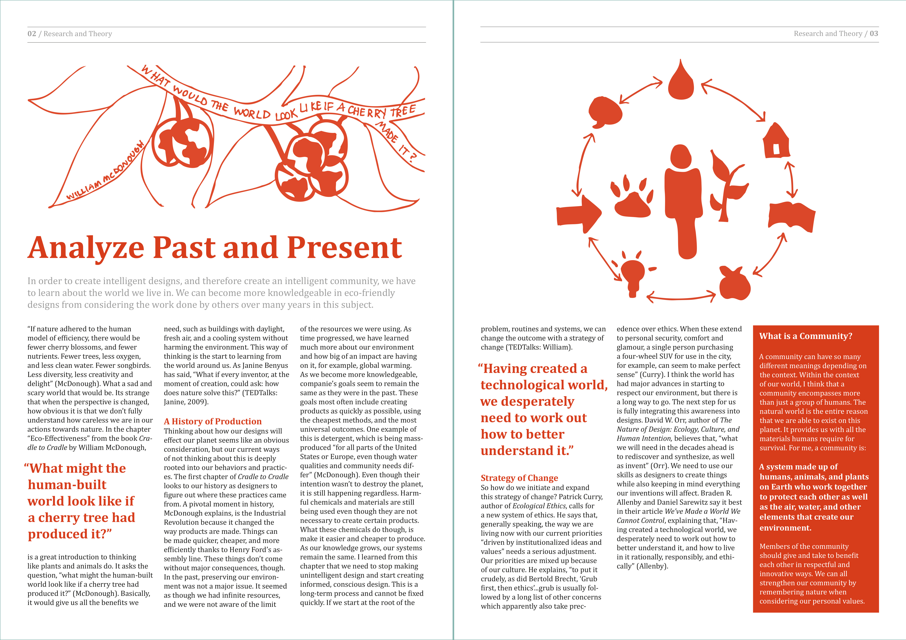
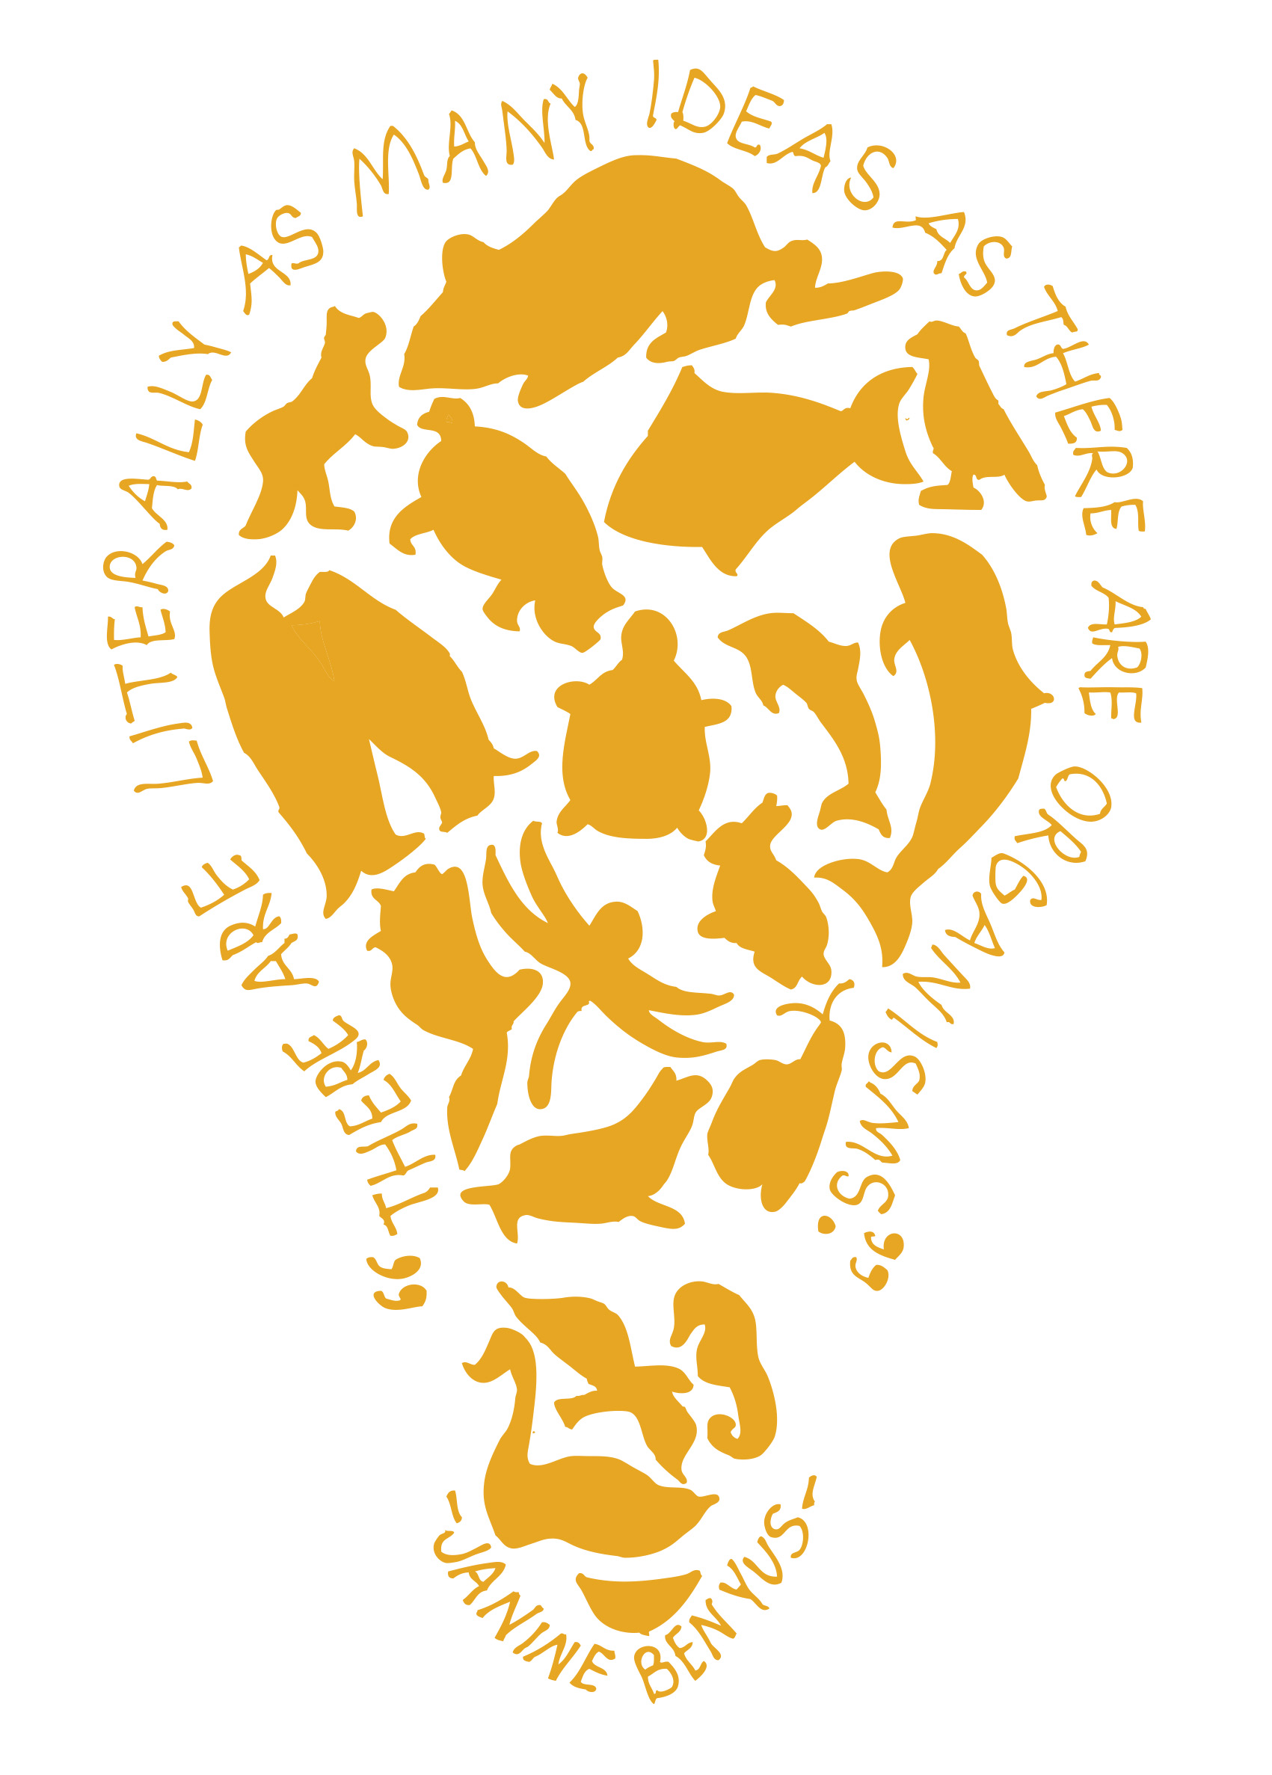
Using nature to inspire Design Values, Issues & Ethics

Slide 30
Using nature to inspire Design Values, Issues & Ethics
‘I feel I now have a relevant perspective from which to begin
to question the things we do, as individuals and as designers,
to begin a change. One not of great challenges to fear, but
one of great expectation on what nature can teach us, when
we listen.’

Slide 31
Using nature to inspire Design Values, Issues & Ethics
‘This course has been challenging in parts. For some time near the beginning of the
project I found it difficult being unsure of exactly what I was working towards as a
final outcome. In the learning model that I am used to it is generally made very clear.
However, I think that I actually learned more because of this uncertainty. Because I
was not always researching with a specific goal in mind I was able to explore and
Experience outside of what I thought I ‘should’ be learning. I was not just absorbing
facts so that I could hand them back in the form of an assignment, but making
discoveries that actually made me consider how, as a designer, I could bring
about change.’

Slide 32
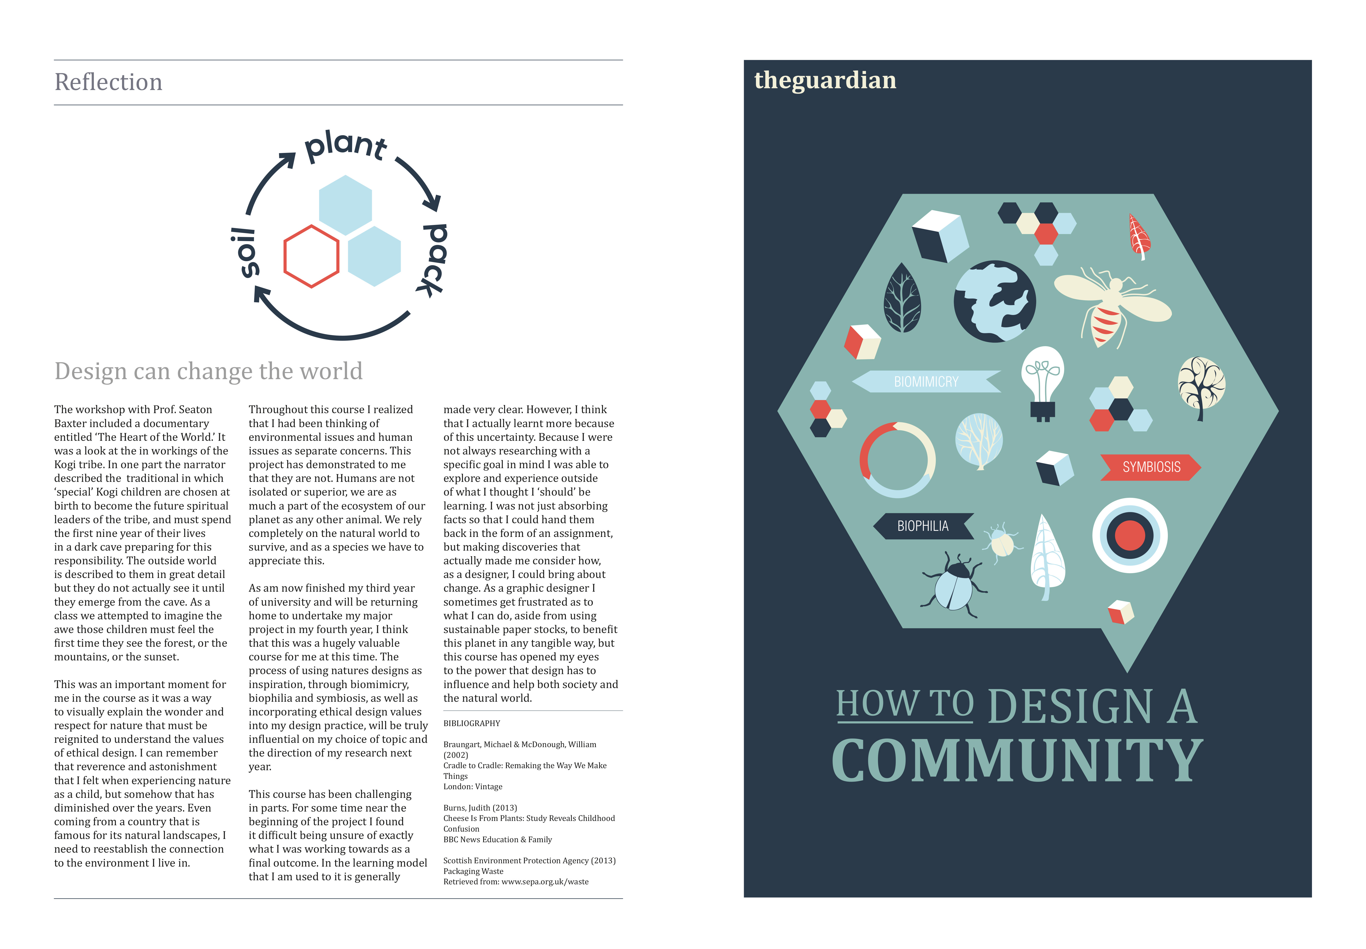
Using nature to inspire Design Values, Issues & Ethics
‘This course has opened my eyes to the power that design
has to influence and help both society and the natural world.’

Slide 33
Using nature to inspire Design Values, Issues & Ethics
The workshops created:
‘… a sense of curiosity and discovery (enchantment with the natural world).’
‘… an awareness of what you are going to leave for future generations and our world.’
Students believed they had achieved a:
‘new way to see and act in the world in which they live.’
and gained ‘a sense of reconciliation between human intention and nature’s purpose.’

Slide 34
Using nature to inspire Design Values, Issues & Ethics
In relation to longevity the students believed they now had:
‘… the tools to become designers of a more sustainable and ethical future
for biodiversity and human well-being.’
‘… broadened my perspective on ethics.’
‘… explore biophilia, biomimicry, resilience and symbiosis through further studies.’

Slide 35
Using nature to inspire Design Values, Issues & Ethics
Reflexivity of the Educator
• Graphic Design & Industrial Design
• Desire and passion to use design as a tool to facilitate ecological
& environmental change
• ‘Self-realisation’
We must become ‘visible and open to debate‘.
Rose, G. (1997) Situating knowledges: positionality, reflexivities and other tactics.
Progress in Human Geography, 21:3, 305-320.

Slide 36
Using nature to inspire Design Values, Issues & Ethics
We need to ‘restore ecological and human scale to a civilisation that has lost its sense of proportion and purpose.’
Orr, David W. 1994, 2004 ed. Earth in Mind: On education, Environment, and the Human Prospect.
Island Press, Washington.

Slide 37
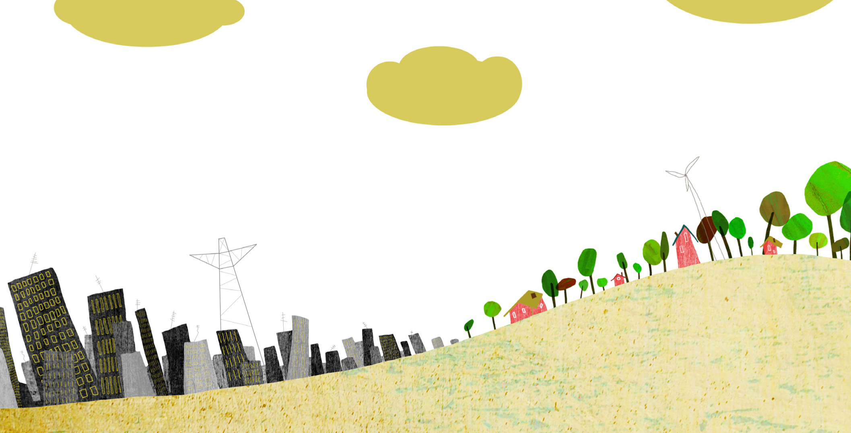
Using nature to inspire Design Values, Issues & Ethics
Thank you
Jackie Malcolm
j.y.malcolm@dundee.ac.uk

