Slide 1
Case Study:
Sustainability and Social Responsibility
Tuesday 26th April, 2022
Dr Beth Christie
bethchristie@ed.ac.uk

Slide 3
UG Sustainability and Social Responsibility (Level 8 - 20 credits)
PG Sustainability and Social Responsibility (Level 11 - 20 credits)
Jointly shared - rotate ownership
School of Education
School of Geosciences
Key points
Running since 2016/17 - refreshed 2021/22
Fully online - taught together - differentiated assessment
Staff inputs from all schools across the University
Elective - open to all students/ all schools across University
Process of review to enable course to take more students… 1000+?

Slide 4
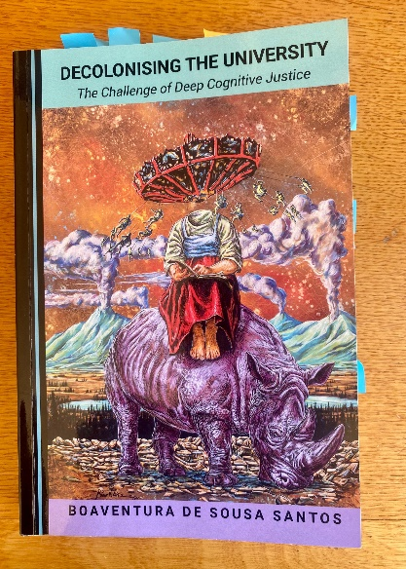
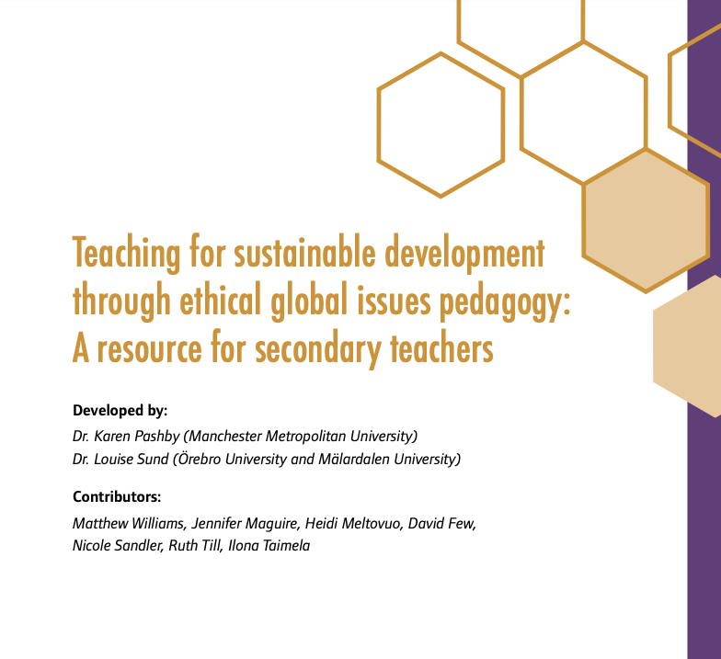
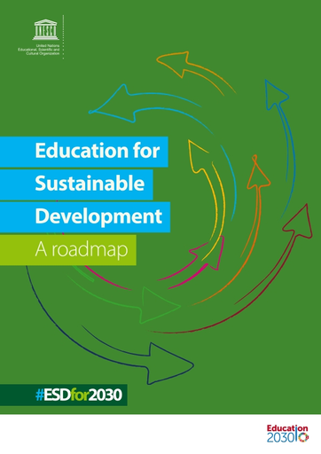
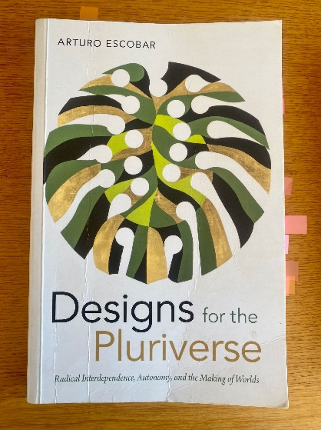
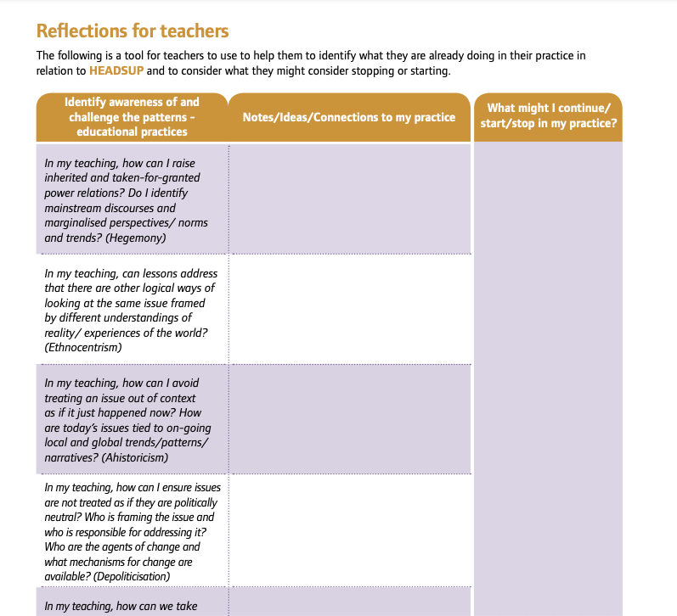
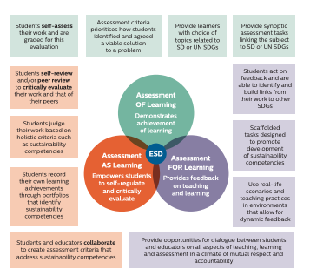
Current context

Slide 5
Curriculum transformation programme funding
Small grant (6month study January – June 2022)
Building on established 5 year history of the course
* Consider opportunities for innovation ‘risk’?
* Consider structure and assessment
2 phase process

Slide 6
Two phase process
Phase 1: (December – January 2022)
Course Development: Refresh and Restructure
• Refresh: The refresh is to bring the course up to date in terms of contemporary knowledges and approaches.
• Restructure: The restructure is to ensure that the course is delivered in a way that makes best use of staff capacity and a structure that would be able to accommodate larger student numbers in the future.
Phase 2: (January - May 2022)
Post-course: Review and recommend
· Review & Analysis: Focus on content and structure. Consider course reports, student feedback, course analytics - where student moved around online etc. Focus groups, review with teaching staff and students.
Recommend: Big picture questions:
how do we tackle issues of assessment if the course was to take on more students
what might assessment look like?
Impact on staffing, workload, student experience?

Slide 7
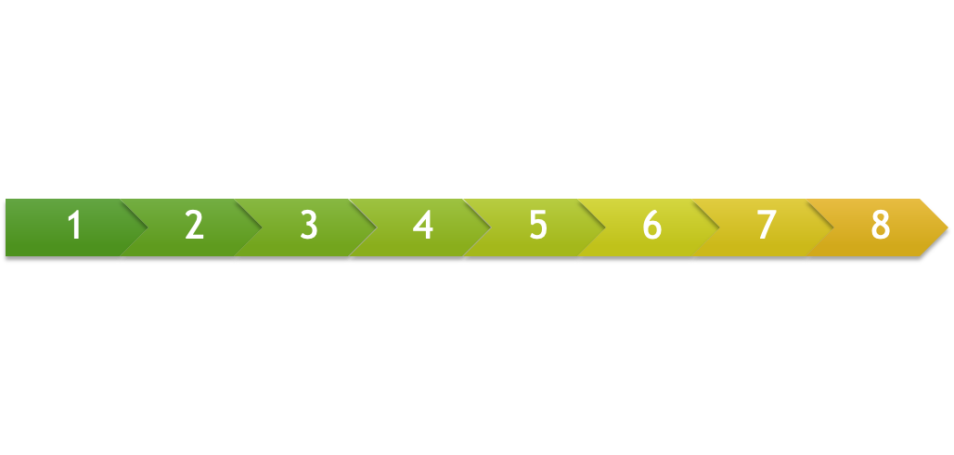
8 week self-led online course
Learning Hub
8 weeks of self led content - comprising lectures, activities
Weekly community discussions
Student self-reflective blog underpinning the 8 weeks.
Knowledge Base
Learning Hub offers starting points - Knowledge base offers more information
Interactive glossary
Encouraged to use as a source of knowledge for assessments

Slide 11
Learning hub
Wk 1: Exploring Sustainability and Social Responsibility
Wk 6: Spheres of Influence
Wk 2: Ways of knowing
Wk 5 Group project
(No formal content)
Wk 7: Moving towards action
Wk 3: Thinking with systems
Wk 8 Futures thinking
Wk 4: Exploring issues and surfacing topics for your group project

Slide 16
Assessment structure
Assessment 1 - UG
Assessment 1 - PG
Weekly self reflective blog (Wk1-7) 20%
100-200 words
peer review
Extended blog post (Week 8) 40%
1500 word reflective essay
Reflecting and critiquing key personal learning and relation to discipline
Weekly self reflective blog Wk1-7 7) 30%
100-200 words
peer review
Extended blog post (Week 8) 30%
3 min video
Reflecting and critiquing key personal learning and relation to discipline
Assessment 2 - UG & PG
Interdisciplinary Group Project (40%) - Week 5
Identify a local SSR issue
Pitch a proposed action/ solution to this issue/problem
Interactive poster (SWAY)

Slide 17
Assessment 1 - UG
Assessment 1 - PG
Weekly self reflective blog posts (Week 1 - 7) 20%
Extended blog post (Week 8) 40%
1500 word reflective essay
Reflecting and critiquing key personal learning and relation to discipline
Weekly self reflective blog posts (Week 1 - 7) 30%
Extended blog post (Week 8) 30%
3 min video
reflecting and critiquing key personal learning and relation to discipline
Assessment 2 - UG & PG
Interdisciplinary Group Project (40%) - Week 5
Identify a local SSR issue
Pitch a proposed action/ solution to this issue/problem
Interactive poster (SWAY)

Slide 18
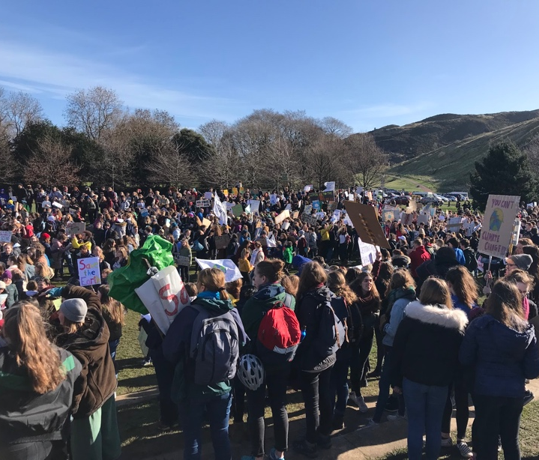
Student feedback
Techniques
Group projects
Miro/ discussions
Activities – provided open frameworks for thinking
Topics
Social justice / activism
Power/ privilege / injustices
Approaches
Interdisciplinarity
Critical stance
Self- reflection
Space and time
Tension
Valued online flexibility – missed face to face discussion!

Slide 19
Next steps…
Positioning
Support for Cross University courses?
Resourcing - money follows students
Increasing capacity
Structuring assessments for larger numbers (1000+)?
Do we need credit bearing courses?
Core competencies as lens / assessment of, as, for learning
Students already self record learning
They could self-assess & peer-assess against competencies, develop a continual portfolio as they progress aligned to graduate attributes and student vision.
Value the process of learning → open ended pedagogy
Phase 1: Created the structure and framework for this to happen
Phase 2: Continues the commitment

Slide 20
THANK YOU
bethchristie@ed.ac.uk

